Slide 1

MOLEX CONNECTED ENTERPRISE SOLUTIONS
AREK WOŹNIAK
TECH SUPPORT MANAGER
50min

Slide 2
cabling for data center
50min

Slide 3





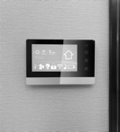


Molex: A Legacy of innovation
1940s
1960s
1980s
2000s
1950s
1970s
1990s
2010s
2020s
1967
Molex creates an international division in Japan to begin working with customers abroad
1972
Molex goes public
2013
Molex is
acquired by Koch
2015
Molex acquires
Oplink to support innovative solutions for optical communications and networking
2016
Molex reinforces commitment
to healthcare
with purchase
of medical
device leader,
Phillips-Medisize
2018
Molex acquires Laird to deliver a seamless vehicle user connectivity
1938
The Krehbiel family develop a durable, thermoplastic material that is molded into flowerpots and toys.
They call their material “Molex.”
1945
Molex produces the first molded terminal block for GE Hotpoint® stoves
1959
Push-button switches opens new markets for Molex, including vending machines and bowling pin setters
1981
Molex helps enable portable video recording with the introduction of miniature interconnects
1993
Filtered header
for automotive
SOLUTIONS PROVIDER
LEADER IN CONNECTORS
Notes:
- For more than 80 years, Molex has been making innovation history
- It’s in our DNA, and continuously supported by new acquisitions, ideas and talent
To mention the highlights:
- We began in 1938 as a family-owned business making moldable thermoplastic.
- This is where the name “Molex” comes from.
- In the 40s, we designed the first molded terminal blocks for GE stoves
- Then came push-button switches for vending machines in the 50s
- In the 80s, we helped usher in the video age with miniature interconnects for video recording
- Our ability to innovate leaped forward in 2013, when we were acquired by Koch and had access to new financial strength and resources
- By the 2000s, we were making acquisitions that rapidly expanded our innovation portfolio — Oplink, Phillips-Medisize and Laird Connected Vehicle Solutions.
- The Phillips-Medisize acquisition helped us move further into healthcare and reinforce our commitment to improving lives

Slide 4


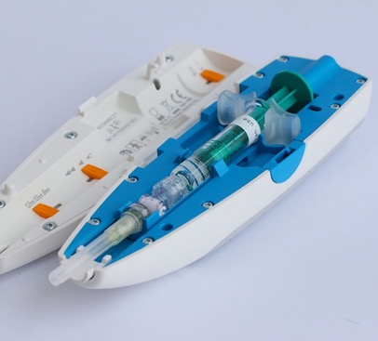
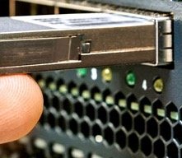

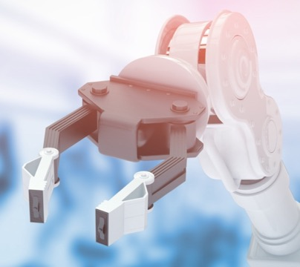
Driving Innovation in
a Changing World
Consumer/Mobile
Advancing the connected devices through the Internet of Things
Medical
Developing and manufacturing innovative products that help people live healthier and more productive lives
Data Center/5G
Accelerating networking that’s ready to go even faster
Automotive
Enabling next-gen vehicle technology to meet changing connectivity needs
Industrial
Collaborating with our customers to enable Digital Manufacturing
4
Notes:
- Molex is a leading innovator, supplier, collaborator and manufacturer
- In key industries driving technological change:
- Consumer/Mobile
- Medical
- Data Center/5G
- Automotive
- Industrial
- Our strong presence in these industries makes us exceptionally well positioned to leverage cross-industry insights and fuel innovation.

Slide 5
Accelerate time-to-market through worldwide design, manufacturing and logistics capabilities.
GLOBAL NETWORK
OF EXPERTISE
Built to serve you better.
199
locations in
40
countries
CUSTOMER EXPERIENCE
MANUFACTURING
DESIGN
WAREHOUSE
AMERICAS
EUROPE
ASIA PACIFIC
74
67
58
5
Notes:
- A key advantage of our global footprint is the ability to bring products to market faster through capabilities that are accessible around the world.
- Our over 230 global locations in 40 countries include 60 in Europe, 17 in Asia Pacific North and 59 in Asia Pacific South.
-Combined with design and logistics expertise, this broad network can dramatically shorten the end-to-end manufacturing cycle.
The building blocks of our service are …
Customer Experience: The Molex sales force has a deep commitment to understanding where customers are going and what they need. They align with customers at the earliest stages of product development.
Manufacturing: end-to-end manufacturing capabilities bring designs to life quickly and at scale.
Design: our product designers and engineers help ensure a design is high performing, cost-effective and manufacturable.
Warehousing: warehouses in strategic global locations are a critical piece of the supply chain, helping ensure that customer orders are delivered when and where they’re needed.

Slide 6
Molex global presence*
Molex Operating Facility
Molex Offices
EUROPE
NORTH AMERICA
ASIA
AFRICA
SOUTH AMERICA
AUSTRALIA
*As of April 2022
6
Notes:
- A key advantage of our global footprint is the ability to bring products to market faster through capabilities that are accessible around the world.
- Our over 230 global locations in 40 countries include 60 in Europe, 17 in Asia Pacific North and 59 in Asia Pacific South.
-Combined with design and logistics expertise, this broad network can dramatically shorten the end-to-end manufacturing cycle.
The building blocks of our service are …
Customer Experience: The Molex sales force has a deep commitment to understanding where customers are going and what they need. They align with customers at the earliest stages of product development.
Manufacturing: end-to-end manufacturing capabilities bring designs to life quickly and at scale.
Design: our product designers and engineers help ensure a design is high performing, cost-effective and manufacturable.
Warehousing: warehouses in strategic global locations are a critical piece of the supply chain, helping ensure that customer orders are delivered when and where they’re needed.

Slide 7

Our vision
We make a connected world possible by working together as a global team to enable technology that transforms the future and improves people’s lives.
100k+
$7B
38
38k+
18k+
86
5%+
Countries
80+
Our Company
Of sales
reinvested
into R&D
Products
Revenue
Employees
Worldwide
Suppliers
Manufacturing Locations
Years OF INNOVATION
Our Markets
AUTOMOTIVE
Home Appliance
Consumer
DATA CENTER/5G
INDUSTRIAL
MEDICAL/PHARMA
Telecom Infrastructure
CUSTOMER
NEEDS
ASSESSMENT
PRODUCT
DESIGN &
INNOVATION
TESTING &
QUALITY
ASSURANCE
SOURCING &
SUPPLY CHAIN
OPTIMIZATION
DESIGN
VERIFICATION
& LAUNCH
DELIVERY
EXCELLENCE
TAILORED
CUSTOMER
SERVICE
Our APPROACH
QUALITY ENGINEERING
Expansive Knowledge Networks
SUPERIOR CUSTOMER EXPERIENCE
Deep engineering expertise
STABLE AND TENURED
MANAGEMENT TEAM
strong financial
foundation
COMMITMENT TO DIVERSITY
AND INCLUSION
Our DIFFERENCE
GLOBAL OPERATIONAL EXCELLENCE
SOUND ENVIRONMENTAL PRACTICES
WORLD-CLASS MANUFACTURING
CAPABILITIES
Privately held
MARKET-BASED MANAGEMENT®
SUPPLY CHAIN INTELLIGENCE
AND AGILITY
DIGITAL
TRANSFORMATION
Our foundation
125k
60+
$125B
2
of the LARGEST privately-held
90%
10k
Employees Worldwide
Countries
Annual Revenue
Reinvested
companies in the U.S.
Patents Granted
Notes:
- It’s no secret that technology is changing rapidly — especially for industries that rely on electronic components and connectivity.
- At Molex, we’ve helped some of the most influential companies embrace change and bring meaningful value to this environment – for themselves, their partners, and of course their customers.
- We’re working with customers, as a global team, to improve lives. That’s our vision:
We make a connected world possible by working together as a global team to enable technology that transforms the future and improves people’s lives.
-Our strength derives from our global presence. Today, we operate in 38 countries, with 18,000 suppliers, 86 manufacturing locations and 100,000 products across converging, dynamic markets.
-

Slide 8
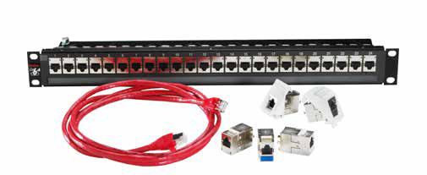
MOLEX CONNECTED ENTERPRISE SOLUTIONS
MOLEX CES
The business part of the Molex Inc. organization.
A pioneer of structured cabling and high-speed data technologies.
Molex CES provides a comprehensive portfolio of copper and fiber structured cabling solutions.
Notes:
One part of Molex's business is designing and manufacturing data transfer solutions. This is handled by Molex CES, which I represent.
With more than three decades of experience delivering enterprise network solutions for some of the largest organizations in the world, Molex Structured Cabling delivers maximum performance, efficiency, reliability and backed by a 25-year warranty.
Therefore, today I want to focus on issues related to the physical layer of data transmission in a data center , which is commonly referred to as cabling.

Slide 9





CABLING STANDARDS FOR DATA CENTERS
TIA-942
ANSI/BICSI 002
ISO/IEC 11801
ISO/IEC 24764
EN 50600
These standards help ensure that data center cabling infrastructure is designed and implemented in a standardized and reliable manner.
Adhering to these standards can help organizations achieve optimal performance, scalability, and maintainability of their cabling systems in the data center environment
9
Notes:
Several standards define cabling in a data center. These standards provide guidelines and best practices for the design, installation, and maintenance of cabling infrastructure. The key standards for cabling in a data center include
TIA-942: The Telecommunications Industry Association (TIA) standard TIA-942 provides guidelines for the design and implementation of data center infrastructure. It covers various aspects, including cabling, pathways, electrical systems, cooling, security, and more. TIA-942 provides recommendations for different tiers of data centers based on their level of redundancy and availability.
2. ANSI/BICSI 002: The American National Standards Institute (ANSI) and the Building Industry Consulting Service International (BICSI) jointly developed ANSI/BICSI 002, which focuses on the design and implementation of data center cabling systems. It covers aspects such as cabling pathways, copper and fiber optic cabling, testing, labeling, and documentation.
3. ISO/IEC 11801: The International Organization for Standardization (ISO) and the International Electrotechnical Commission (IEC) collaboratively developed ISO/IEC 11801, which provides guidelines for generic cabling systems, including those used in data centers. It covers cabling performance, installation practices, and testing requirements for copper and fiber optic cabling.
4. ISO/IEC 24764: This standard focuses specifically on cabling infrastructure for data centers. ISO/IEC 24764 provides recommendations for design, installation, and maintenance of cabling systems in data center environments. It covers aspects such as cabling topology, pathways, copper and fiber optic cabling, and testing requirements.
These standards help ensure that data center cabling infrastructure is designed and implemented in a standardized and reliable manner. Adhering to these standards can help organizations achieve optimal performance, scalability, and maintainability of their cabling systems in the data center environment.
It's important to note that standards and norms can vary depending on the region, industry, and specific requirements of a data center. Staying up to date with the latest standards and consulting with industry professionals can help ensure compliance and best practices in the design and operation of a data center's physical infrastructure.

Slide 10
the role of cabling in the data center
Connectivity
Bandwidth and Speed
Data Integrity
Scalability
Cabling forms the backbone of the data center, enabling reliable and efficient communication between various components.
It is crucial to invest in high-quality cabling infrastructure, proper installation, and regular maintenance to ensure optimal performance, data integrity, and scalability within the data center environment.
Flexibility and Modularity
Cable Management
Compliance and Standards
10
Notes:
Cabling plays a crucial role in the data center as it forms the backbone of the entire infrastructure, facilitating reliable and efficient communication between various components and equipment. Here are some key roles of cabling in the data center:
Connectivity: Cabling provides the physical connections that enable data transmission between servers, storage devices, switches, routers, and other network equipment. It establishes the network infrastructure that allows for seamless communication and data exchange within the data center.
Bandwidth and Speed: The quality and type of cabling used in the data center impact the bandwidth and speed of data transmission. High-quality cabling, such as fiber optic, can support higher data rates and greater bandwidth, allowing for faster and more efficient communication between devices.
Data Integrity: Properly installed and maintained cabling helps ensure data integrity. It minimizes signal loss, electromagnetic interference (EMI), and crosstalk, which can negatively impact data transmission quality and accuracy. Reliable cabling helps maintain the integrity of critical data and prevents errors or data loss.
Scalability: Cabling infrastructure should be designed to accommodate future growth and scalability. Well-planned cabling allows for easy expansion, additions, and changes within the data center without disrupting the existing infrastructure. Scalable cabling enables organizations to adapt to evolving technology needs and accommodate increased data traffic.
Flexibility and Modularity: Modular cabling solutions, such as structured cabling systems, provide flexibility in connecting various devices and equipment within the data center. They allow for easy reconfiguration, upgrades, and modifications as the data center requirements change over time. Modular cabling reduces downtime and simplifies maintenance and troubleshooting processes.
Cable Management: Proper cable management is essential for maintaining an organized and efficient data center environment. Well-managed cabling reduces the risk of cable damage, facilitates airflow for cooling, and simplifies maintenance and troubleshooting tasks. Cable management solutions, such as cable trays, racks, and labels, help keep the cabling infrastructure organized and easily accessible.
Compliance and Standards: Cabling in the data center should adhere to industry standards and guidelines, ensuring proper installation, safety, and compliance. Following standards, such as TIA-942 and ANSI/BICSI 002, helps ensure the reliability, performance, and longevity of the cabling infrastructure.
Overall, cabling forms the backbone of the data center, enabling reliable and efficient communication between various components. It is crucial to invest in high-quality cabling infrastructure, proper installation, and regular maintenance to ensure optimal performance, data integrity, and scalability within the data center environment.

Slide 11

What cabling to choose for your data center?
Copper Cabling
  Category 6A (Class FA)
  Category 8 (Class I and Class II)
Fiber Optic Cabling
  Multimode OM4 and OM5
  Singlemode
Ultimately, the choice of cabling for a data center depends on the specific requirements and goals of the organization.
It is often beneficial to consult with cabling professionals or data center experts to determine the most suitable cabling solution for your data center infrastructure
11
Notes:
When choosing cabling for a data center, several factors need to be considered, including bandwidth requirements, distance limitations, future scalability, and budget. The two primary types of cabling commonly used in data centers are copper and fiber optic. Here's an overview of each:
1. Copper Cabling:
- Category 6A (Cat6A): Cat6A cabling supports 10 Gigabit Ethernet (10GBASE-T) and offers improved performance and reduced crosstalk compared to its predecessor, Cat6.
- Category 8 (Cat8): Cat8 cabling is designed to support 25 and 40 Gigabit Ethernet (25GBASE-T and 40GBASE-T) over shorter distances (max. 30m). It provides higher bandwidth and improved performance than Cat6A but is more expensive, offers shorter distance, different connectors (GG45, TERRA) and limited availability.
2. Fiber Optic Cabling:
- Multimode Fiber (MMF): OM4 and OM5 are commonly used multimode fiber types in data centers. OM4 supports 10, 40, and 100 Gigabit Ethernet up to 550 meters, while OM5 extends it to 1000 meters. MMF is suitable for shorter to medium distances within the data center.
- Single-mode Fiber (SMF): SMF provides the longest reach and highest bandwidth capacity. It is commonly used for longer distances in data centers, such as connections between buildings or for long-haul applications.
Ultimately, the choice of cabling for a data center depends on the specific requirements and goals of the organization. It is often beneficial to consult with cabling professionals or data center experts to determine the most suitable cabling solution for your data center infrastructure
While Cat 8 cabling offers several advantages, it also has a few disadvantages to consider:
1. Cost: Cat 8 cables and associated components tend to be more expensive compared to lower category cables like Cat 6 or Cat 6A. The higher cost is primarily due to the increased performance and specifications required for Cat 8, including shielding, construction, and connectors.
2. Limited Distance: Cat 8 cables have a shorter maximum reach compared to lower category cables. While Cat 6 and Cat 6A can support 10 Gigabit Ethernet at distances up to 55 meters and 100 meters, respectively, Cat 8 is limited to 30 meters for 25/40Gbps and 24 meters for 50/100Gbps. This limitation may require additional infrastructure planning, such as the placement of network equipment closer to endpoints or the use of intermediate equipment like switches or repeaters.
3. Compatibility: Cat 8 cables use different connectors compared to lower category cables. Instead of the familiar RJ45 connectors, Cat 8 cables typically use the TERA or GG45 connectors. This means that existing network equipment and infrastructure designed for RJ45 connectors may not be compatible without adapters or replacement.
4. Limited Availability: Cat 8 is a relatively new standard, and as such, it may not be as widely available as lower category cables. Availability of Cat 8 cables, connectors, and compatible equipment may be more limited, which can impact the ease of sourcing and installation.

Slide 12
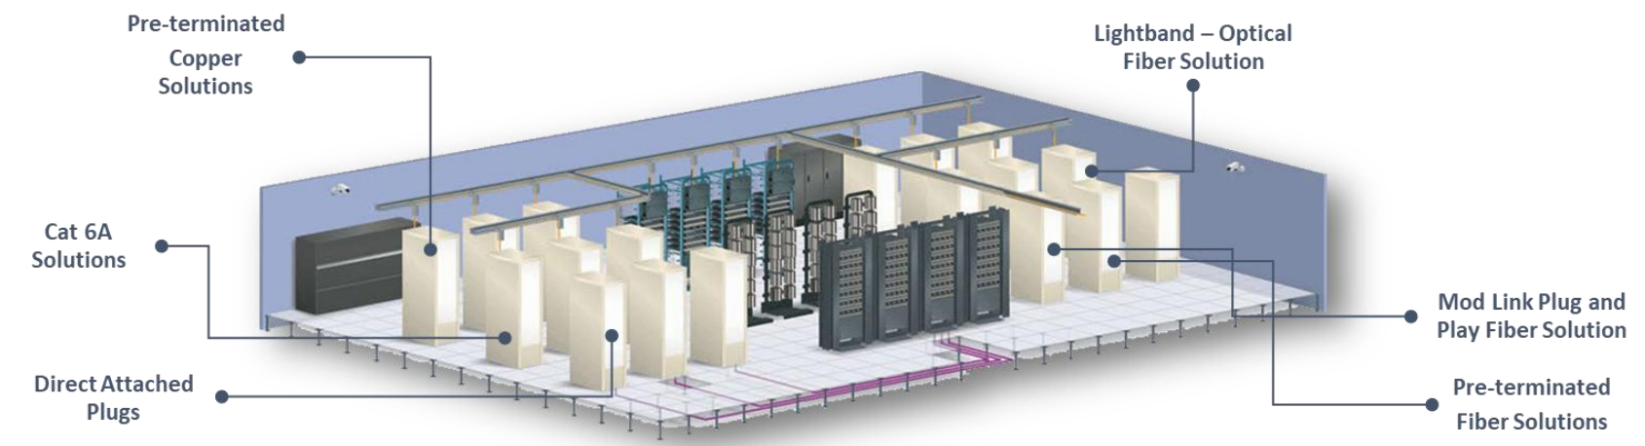
What cabling to choose for your data center?
Bandwidth Requirements
Distance Limitations
Scalability
Cost
Compatibility
Ultimately, the choice of cabling for a data center depends on the specific requirements and goals of the organization.
It is often beneficial to consult with cabling professionals or data center experts to determine the most suitable cabling solution for your data center infrastructure
12
Notes:
When selecting cabling for a data center, consider the following:
1. Bandwidth Requirements: Determine the current and future bandwidth needs of the data center. If higher speeds are required, fiber optic cabling may be preferable.
2. Distance Limitations: Consider the distance between equipment and determine whether copper or fiber optic cabling is appropriate. Fiber optic cabling is capable of longer distances compared to copper cabling.
3. Scalability: If future scalability is a concern, fiber optic cabling offers higher bandwidth capacity and longer reach, making it a more future-proof option.
4. Cost: Copper cabling is generally more affordable than fiber optic cabling. Consider your budget while ensuring the chosen cabling meets the necessary performance requirements.
5. Compatibility: Ensure that the selected cabling is compatible with the networking equipment and protocols being used within the data center.
Ultimately, the choice of cabling for a data center depends on the specific requirements and goals of the organization. It is often beneficial to consult with cabling professionals or data center experts to determine the most suitable cabling solution for your data center infrastructure

Slide 13
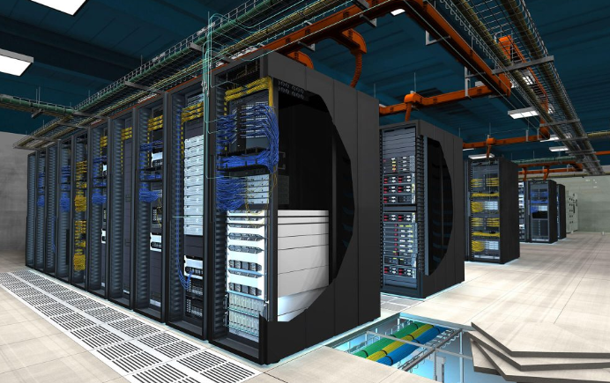
cabling development directions for data centers
Higher Speeds
Fiber Optic Dominance
Migration to Single-mode Fiber
Higher Density and Flexibility
Power over Ethernet (PoE)
These cabling development directions aim to address the evolving needs of data centers, enabling them to handle higher data volumes, faster speeds, and greater reliability.
Organizations should stay updated on these developments to adopt the most suitable cabling solutions for their data center infrastructure
Cable Management and Modularity
Enhanced Testing and Monitoring
13
Notes:
Cabling development in data centers is driven by the need for higher bandwidth, faster speeds, improved reliability, and increased flexibility. Here are some key cabling development directions for data centers:
1. Higher Speeds: As data centers continue to handle increasing amounts of traffic, there is a demand for higher-speed cabling solutions. For example, advancements in fiber optic cabling, such as the development of OM5 (Wideband Multimode Fiber), enable higher speeds of 40G, 100G, and beyond.
2. Fiber Optic Dominance: Fiber optic cabling is becoming increasingly prevalent in data centers due to its superior performance, longer reach, and higher bandwidth capabilities. As data centers require faster and more reliable connections, the adoption of fiber optic cabling is expected to grow.
3. Migration to Single-mode Fiber: As data centers expand and distances between equipment increase, there is a shift towards single-mode fiber (SMF). SMF provides greater reach and higher bandwidth capacity, making it suitable for long-haul applications and connections between data centers.
4. Higher Density and Flexibility: Data centers are becoming more dense and compact, requiring cabling solutions that can accommodate a higher number of connections in a limited space. High-density cabling solutions, such as MPO/MTP connectors and ribbon fiber cables, are being developed to address this need.
5. Power over Ethernet (PoE): With the proliferation of Internet of Things (IoT) devices and the need for power delivery to various equipment, PoE is gaining importance in data centers. Cabling development is focusing on supporting higher power levels and more efficient power delivery over Ethernet cables.
6. Cable Management and Modularity: Effective cable management is crucial for maintaining an organized and efficient data center environment. Development efforts are focused on creating modular and flexible cabling systems that simplify installation, reconfiguration, and maintenance processes.
7. Enhanced Testing and Monitoring: With the increasing complexity of data center cabling, there is a need for advanced testing and monitoring solutions. Development efforts are focused on creating tools and technologies that can accurately test and monitor the performance of cabling infrastructure, ensuring optimal signal quality and identifying potential issues.
8. Energy Efficiency: Cabling development is also focused on improving energy efficiency within data centers. Efforts are being made to reduce power consumption and heat generation in cabling systems, contributing to overall energy savings in the data center environment.
These cabling development directions aim to address the evolving needs of data centers, enabling them to handle higher data volumes, faster speeds, and greater reliability. Organizations should stay updated on these developments to adopt the most suitable cabling solutions for their data center infrastructure

Slide 14
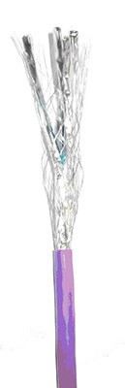
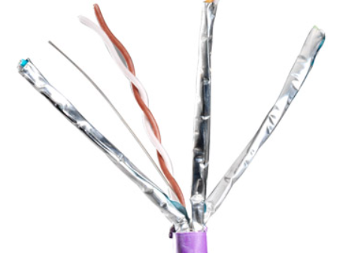
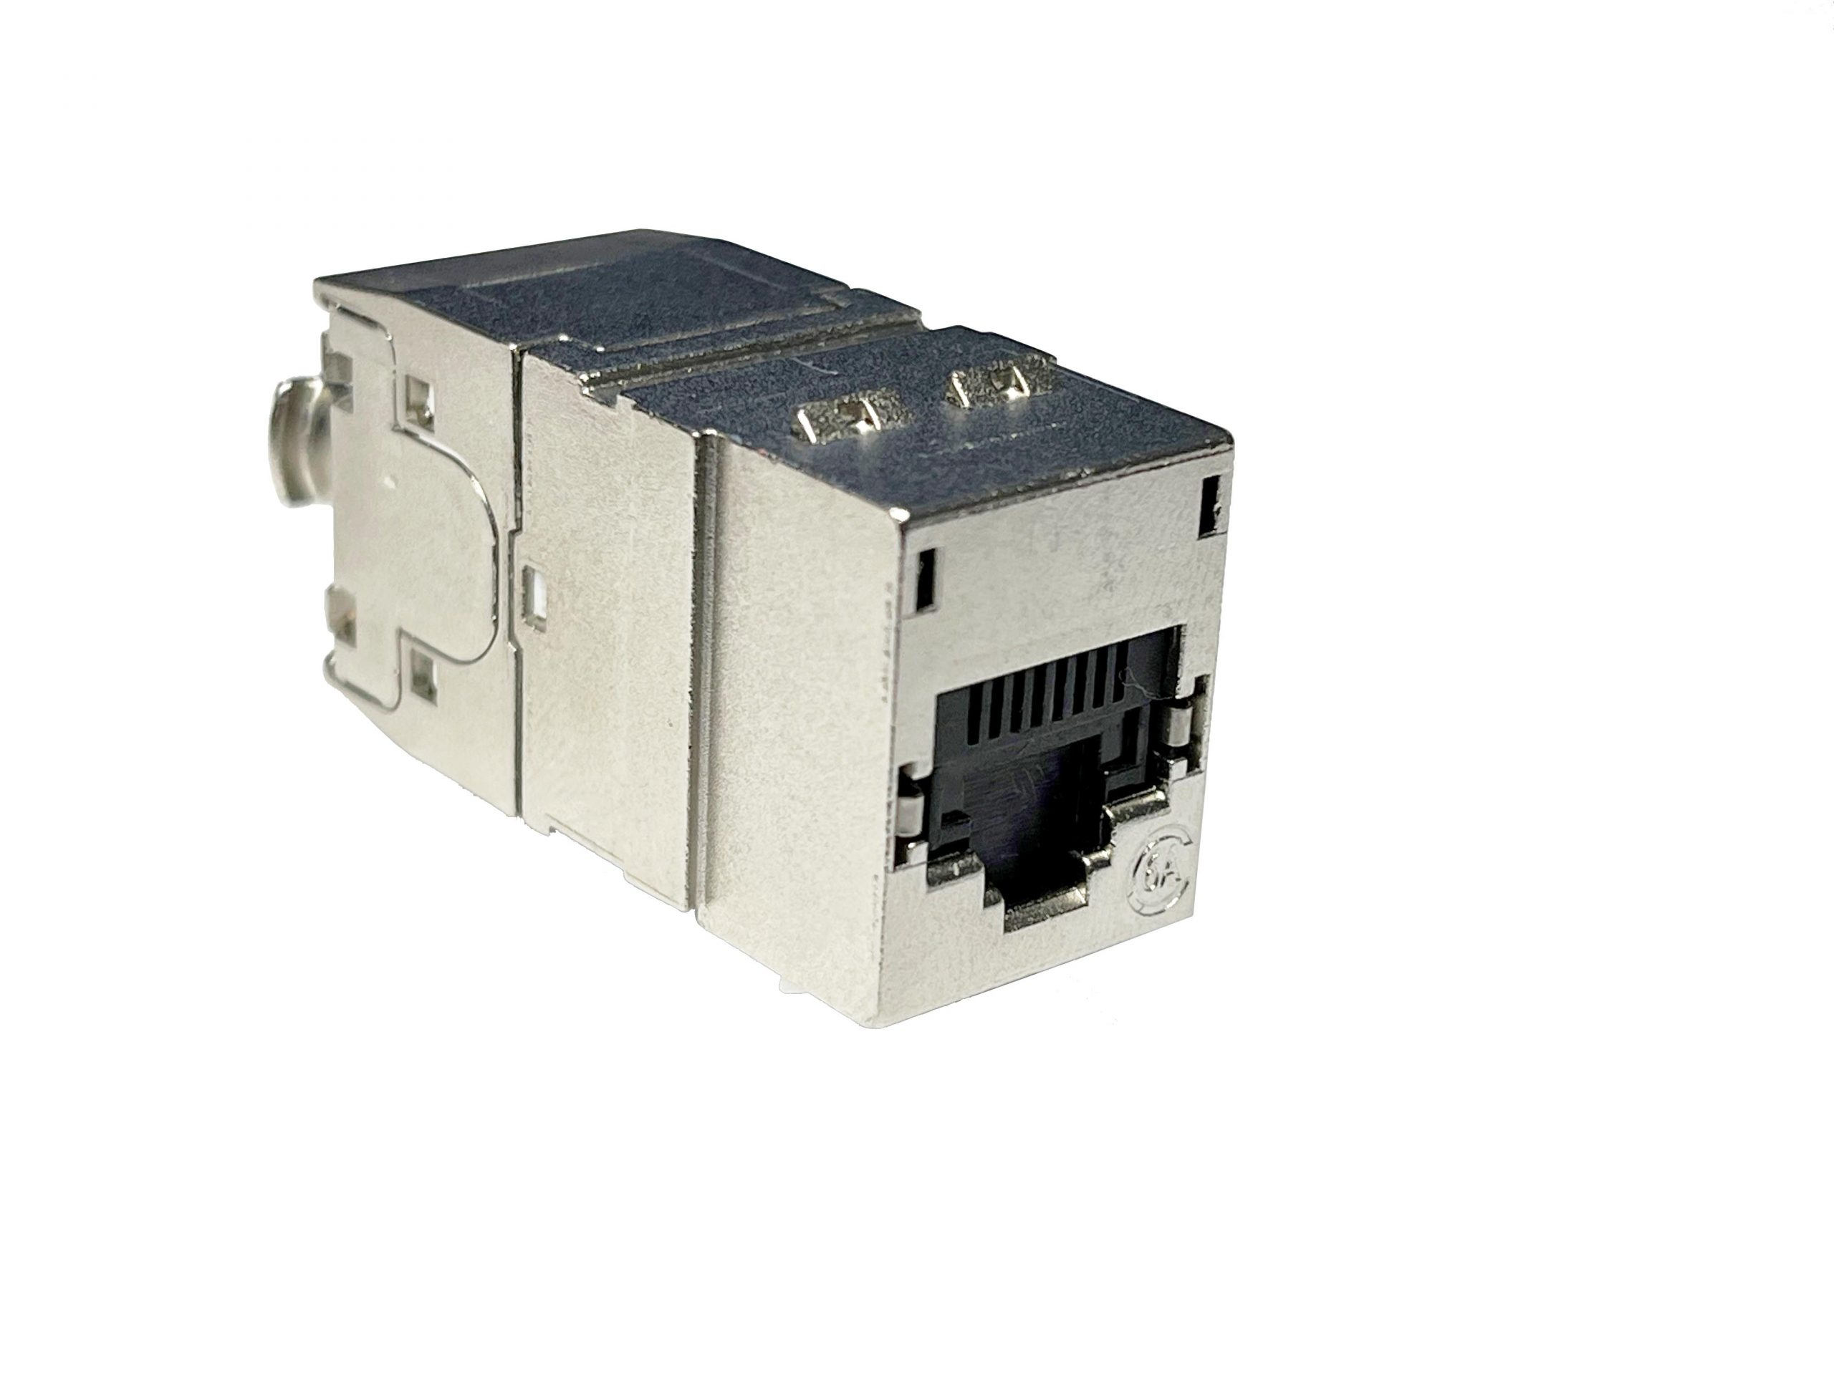
Power cat 6a - Cat 6A cabling in a data center
Bandwidth and Data Rates
Enhanced Performance
Cable Construction
Connector Compatibility
Power over Ethernet (PoE)
Cat 6A provides a robust and future-proof cabling solution for data centers, offering high-speed and reliable connectivity required for modern data center applications.
However, it's important to consult with cabling professionals and follow the specific guidelines and recommendations of the cabling manufacturer to ensure proper installation and adherence to the Cat 6A standard in your data center
Standards Compliance
14
Notes:
The Cat 6A (Category 6A) standard is commonly used in data centers to provide high-speed and reliable network connectivity. Here are some key aspects of the Cat 6A standard for data centers:
1. Bandwidth and Data Rates: Cat 6A supports data rates of up to 10 Gigabits per second (10Gbps) over a distance of 100 meters. It provides sufficient bandwidth for demanding data center applications, including cloud computing, virtualization, and high-performance computing.
2. Enhanced Performance: Cat 6A features improved specifications compared to its predecessor, Cat 6. It has stricter crosstalk and noise requirements, which reduce interference and ensure better signal quality, resulting in higher network performance and reliability.
3. Cable Construction: Cat 6A cables typically have four individually shielded twisted pairs (U/FTP) or an overall shielded construction (S/FTP). The shielding helps to minimize alien crosstalk and external electromagnetic interference, which is crucial in data center environments with high-density cabling.
4. Connector Compatibility: Cat 6A cables use RJ45 connectors, which are compatible with standard Ethernet ports commonly found in data center network equipment, such as switches, routers, and servers.
5. Power Over Ethernet (PoE) Support: Cat 6A cables can also support Power over Ethernet applications, including PoE and PoE+ (802.3af and 802.3at standards). This allows for the simultaneous transmission of data and power over the same cable, facilitating the deployment of network devices such as IP cameras, wireless access points, and VoIP phones. Cat 6A is the recommended platform for PoE by all standardization organizations.
6. Standards Compliance: Cat 6A cables and components must meet industry standards, such as TIA-568, ISO/IEC 11801, and ANSI/TIA-1152. Compliance with these standards ensures interoperability, performance, and compatibility with other networking equipment.
Cat 6A provides a robust and future-proof cabling solution for data centers, offering high-speed and reliable connectivity required for modern data center applications. However, it's important to consult with cabling professionals and follow the specific guidelines and recommendations of the cabling manufacturer to ensure proper installation and adherence to the Cat 6A standard in your data center

Slide 15
Pre-terminated cat 6a cable harnesses
High-performance
Easy installation
Customizable lengths
Quality and reliability
Flexibility
Pre-terminated Cat 6a cable harnesses are commonly used in data centers, enterprise networks, and other applications where quick and reliable network installations are required.
They provide a convenient and efficient solution for connecting network devices, ensuring optimal performance and reducing installation time.
Future-proofing
15
Notes:
Preterminated Cat 6a cable harnesses are preassembled cables that consist of multiple Cat 6a cables terminated with connectors on both ends. These cable harnesses are designed to provide a plug-and-play solution for network installations, saving time and effort required for on-site cable termination.
Here are a few key features and benefits of preterminated Cat 6a cable harnesses:
1. High-performance: Cat 6a cables support data transmission at speeds up to 10 Gigabit Ethernet, making them suitable for high-bandwidth applications and networks that require fast and reliable data transfer.
2. Easy installation: Preterminated cable harnesses come with connectors already terminated on both ends, eliminating the need for on-site termination. This simplifies the installation process, reduces the chances of errors, and saves time on the job site.
3. Customizable lengths: Cable harnesses can be tailored to specific length requirements, ensuring that they fit perfectly within the installation environment. This helps to minimize cable clutter and ensures efficient cable management.
4. Quality and reliability: Preterminated cable harnesses are typically factory-assembled, ensuring consistent quality and reliable performance. These cables are tested before leaving the factory, guaranteeing that they meet or exceed industry standards.
5. Flexibility: Cable harnesses can be designed with various connector types, such as RJ45, to accommodate different network equipment and infrastructure. This allows for seamless integration into existing network setups.
6. Future-proofing: Cat 6a cables provide higher performance and improved signal integrity compared to Cat 6 cables, making them a suitable choice for future network upgrades and expansions. Preterminated cable harnesses ensure that the network infrastructure is capable of supporting future bandwidth requirements.
Preterminated Cat 6a cable harnesses are commonly used in data centers, enterprise networks, and other applications where quick and reliable network installations are required. They provide a convenient and efficient solution for connecting network devices, ensuring optimal performance and reducing installation time.

Slide 16
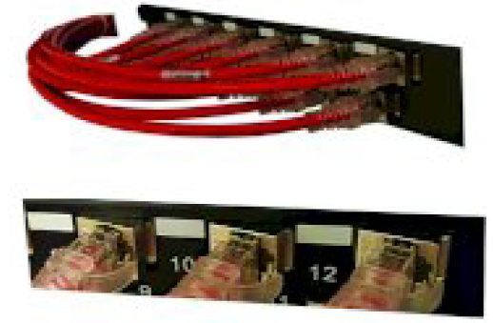
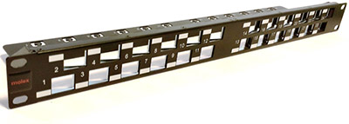
Angled patch panels
Space Optimization
Improved Cable Management
Enhanced Airflow
Increased Port Density
Easy Identification
When considering angled patch panels, it's important to ensure compatibility with the specific requirements of your network infrastructure.
Consulting with cabling professionals or data center experts can help determine the most suitable solution and ensure proper installation and cable management practices.
16
Notes:
Angled patch panels are a type of high-density solution commonly used in data centers. They are designed with a slight angle or orientation to optimize cable management and improve airflow within the rack. Here are some key features and benefits of angled patch panels:
1. Space Optimization: Angled patch panels allow for better space utilization within the rack. The angled design allows the patch cords to be routed neatly along the side of the panel, reducing cable congestion and minimizing the amount of space required for cable management. The use of angle panels makes it possible to dispense with the use of horizontal cable organizers between panels.
2. Improved Cable Management: The angled orientation of the patch panel helps in organizing and managing the patch cords. The cables can be easily routed to the vertical cable management or pathway, keeping them organized and preventing tangling or accidental disconnections.
3. Enhanced Airflow: By routing the patch cords along the side of the angled patch panel, the airflow within the rack is improved. This helps in maintaining optimal cooling for the network equipment, reducing the risk of overheating and improving overall system performance and reliability.
4. Increased Port Density: Angled patch panels typically support a higher number of ports compared to traditional flat patch panels. This allows for higher port density in the same amount of rack space, making them suitable for data centers with limited space availability.
5. Easy Identification: Angled patch panels often feature clear labeling and color-coded ports, making it easier to identify and manage the connections. This helps in reducing errors during maintenance and troubleshooting activities.
When considering angled patch panels, it's important to ensure compatibility with the specific requirements of your network infrastructure. Consulting with cabling professionals or data center experts can help determine the most suitable solution and ensure proper installation and cable management practices.
We offer two types of angle panels shown in the photos. The first has an angled faceplate design while the second has a straight faceplate, but the ports are angled.

Slide 17
high-density panels
Port density
Space-saving design
Cable management
Ease of installation
Compatibility
It's important to note that high-density copper patch panels may require appropriate cable management and routing considerations to ensure efficient airflow, maintain signal integrity, and minimize crosstalk or interference between cables.
Proper planning and design are essential for maximizing the benefits of high-density patch panels in network installations.
Scalability
17
Notes:
High-density copper patch panels are network infrastructure components used for terminating and organizing copper cables in a compact and space-efficient manner. These patch panels are designed to accommodate a larger number of ports within a limited physical space, allowing for higher port density in network racks or cabinets.
Here are some key features and benefits of high-density copper patch panels:
1. Port density: High-density patch panels are specifically designed to maximize the number of ports in a given space. They typically feature a higher number of ports per rack unit (U), allowing for more efficient use of rack space and reducing the need for additional racks or cabinets.
2. Space-saving design: These patch panels are compact and often feature a vertical orientation, which helps save valuable rack space. They are ideal for installations where space is limited, such as data centers or telecom rooms.
3. Cable management: High-density patch panels often incorporate built-in cable management features, such as cable rings, guides, and pathways. These features help organize and route cables neatly, reducing clutter and improving airflow within the rack.
4. Ease of installation: Many high-density patch panels feature tool-less termination options, making installation quick and straightforward. They may also include color-coded or labeled ports for easy identification and troubleshooting.
5. Compatibility: These patch panels are typically designed to support a wide range of copper cable types, such as Cat 5e, Cat 6, Cat 6a, and even higher-grade cables. They can be used for a variety of network applications, including Ethernet, voice, and data.
6. Scalability: High-density patch panels provide scalability for future network expansions. They can easily accommodate additional ports or modules as the network grows, allowing for seamless upgrades without major infrastructure changes.
It's important to note that high-density copper patch panels may require appropriate cable management and routing considerations to ensure efficient airflow, maintain signal integrity, and minimize crosstalk or interference between cables. Proper planning and design are essential for maximizing the benefits of high-density patch panels in network installations.

Slide 18
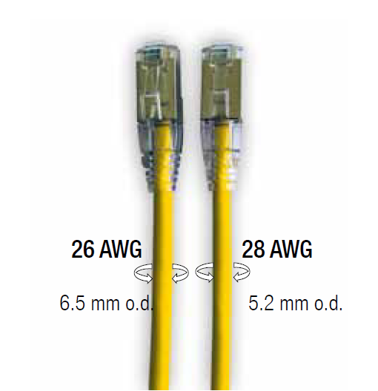
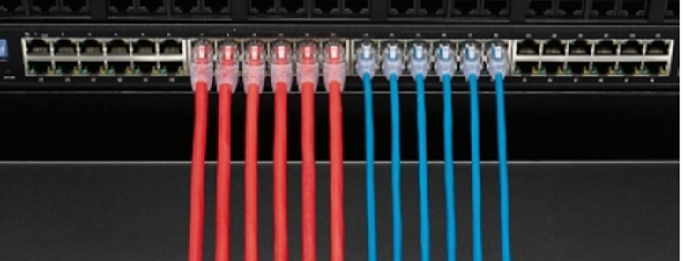
SLIM patch cords
Wire Gauge
Performance
Flexibility and Space
Signal Loss
PoE
Ultimately, the choice between 26 AWG and 28 AWG patch cords for Cat 6A solutions depends on specific requirements, including space limitations, installation preferences, and budget considerations.
It's recommended to consult with cabling professionals or follow the recommendations of the cabling manufacturer to ensure compatibility and optimal performance for your specific application.
Cost
18
Notes:
When it comes to Cat 6A solutions, one consideration is the choice between 26 AWG and 28 AWG patch cords. Here's a comparison of these two options:
1. Wire Gauge: AWG stands for American Wire Gauge, which indicates the size of the wire conductor. In this case, 26 AWG and 28 AWG represent different wire thicknesses. Note that the larger the number, the smaller the diameter of the conductor.
2. Performance: In terms of performance, both 26 AWG and 28 AWG patch cords can meet the requirements of Cat 6A standards, which specify support for 10 Gigabit Ethernet over distances up to 100 meters. Both options are capable of delivering the necessary bandwidth and signal integrity for high-speed data transmission.
3. Flexibility and Space: 28 AWG patch cords are thinner and more flexible compared to 26 AWG. This can be advantageous in situations where space is limited, such as in densely populated data center racks or cabinets. The smaller diameter of 28 AWG cords allows for easier cable management and improved airflow.
4. Signal Loss: Due to the thicker conductor, 26 AWG patch cords generally have lower electrical resistance compared to 28 AWG cords. This can result in slightly less signal loss over longer cable runs, which may be beneficial in certain scenarios where longer distances are involved.
5. PoE - due to the thinner conductor, the resistance of 28AWG cables is higher. This has a significant impact not only on the signal loss but also on the voltage drop, and thus the increase in the heat released. This will be especially important if you use these cables for PoE operation.
6. Cost: 28 AWG patch cords are typically less expensive than 26 AWG cords. This cost difference can be a consideration when deploying large quantities of patch cords in a data center or network infrastructure.
Ultimately, the choice between 26 AWG and 28 AWG patch cords for Cat 6A solutions depends on specific requirements, including space limitations, installation preferences, and budget considerations. It's recommended to consult with cabling professionals or follow the recommendations of the cabling manufacturer to ensure compatibility and optimal performance for your specific application.

Slide 19
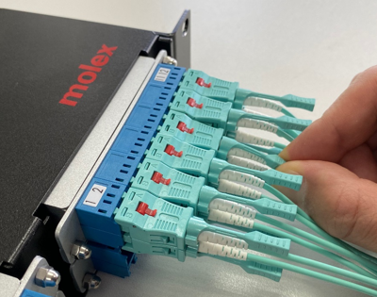
High-density fiber optic panels
Port density
Modular design
Fiber optic connector compatibility
Cable management features
Fiber optic performance
By considering these factors, data centers can select high-density fiber optic patch panels that optimize space, enhance cable management, and support scalability for future growth and network expansion
Integration with data center infrastructure
Labeling and identification
19
Notes:
High-density fiber optic patch panels are particularly useful in data center environments where space optimization and efficient cable management are crucial. These patch panels allow data centers to accommodate a larger number of fiber optic connections within limited rack space. Here are some key considerations for high-density fiber optic patch panels in data centers:
1. Port density: High-density patch panels are designed to provide a higher number of fiber optic ports per rack unit (U). Look for patch panels that offer maximum port density to make the most efficient use of limited rack space.
2. Modular design: Choose patch panels with a modular design that allows for easy insertion and removal of fiber optic cassettes or modules. This modular approach simplifies installation, upgrades, and maintenance in data center environments where flexibility and scalability are essential.
3. Fiber optic connector compatibility: Consider the types of fiber optic connectors commonly used in your data center environment. Popular connector types such as LC, SC, or MPO/MTP should be supported by the patch panels to ensure compatibility with existing fiber optic infrastructure.
4. Cable management features: High-density patch panels should include built-in cable management features to facilitate proper cable routing and organization. These features can include cable trays, fiber management panels, or bend radius control mechanisms. Effective cable management is crucial in data centers to ensure signal integrity and prevent cable mess.
5. Fiber optic performance: Verify that the patch panels meet or exceed the performance requirements of your data center network. This includes considerations such as fiber optic cable type (single-mode or multimode), performance specifications (e.g., OM3, OM4, OS2), and compatibility with the desired data transmission speeds.
6. Integration with data center infrastructure: Ensure that the high-density patch panels can seamlessly integrate with other data center infrastructure components such as racks, cabinets, and fiber optic enclosures. Compatibility with industry-standard rack sizes and mounting options is essential for easy installation and maintenance. An example is front patch cable organizers, which can force the front racks of a cabinet backwards.
7. Labeling and identification: Choose patch panels that provide clear labeling and identification options for easy identification and troubleshooting. Clear port labeling and color-coding can help streamline cable management and minimize errors in large-scale data center environments.
By considering these factors, data centers can select high-density fiber optic patch panels that optimize space, enhance cable management, and support scalability for future growth and network expansion.

Slide 20
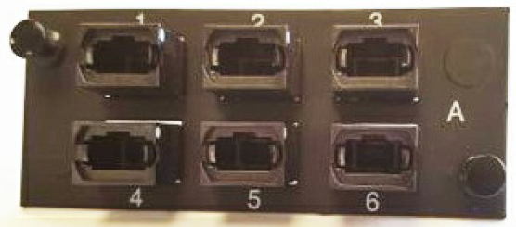
Modlink - MPO solutions for data centers
MPO Patch Cables
MPO Patch Panels
MPO Cassettes
MPO Trunk Cables
MPO Breakout Cables
MPO solutions offer advantages in terms of high-density connectivity, rapid deployment, and simplified cable management in data center environments. They enable efficient use of rack space, facilitate quick and easy installations, and support future scalability and flexibility.
20
Notes:
MPO (Multi-Fiber Push-On) solutions are widely used in data centers for high-density fiber optic connectivity. MPO connectors provide a compact and efficient way to connect multiple fibers in a single connector, reducing the amount of space required for fiber optic connections. Here are some MPO solutions commonly used in data centers:
1. MPO Patch Cables: MPO patch cables are pre-terminated fiber optic cables with MPO connectors on both ends. They allow for quick and easy connection between MPO patch panels, MPO cassettes, or other MPO-compatible devices. MPO patch cables are available in different fiber types (single-mode or multimode) and can support various transmission speeds.
2. MPO Patch Panels: MPO patch panels are designed to accommodate MPO connectors and provide a centralized termination point for multiple fibers. They typically have high port density, allowing for the termination of a large number of MPO patch cables in a compact space. MPO patch panels often feature modular designs, allowing for easy installation, maintenance, and scalability.
3. MPO Cassettes: MPO cassettes are modular units that provide a transition from MPO connectors to individual LC or SC connectors. They are often used in high-density applications where individual fiber connections are required. MPO cassettes can be easily inserted into MPO patch panels or enclosures, providing flexibility and enabling quick changes or additions to the network.
4. MPO Trunk Cables: MPO trunk cables are multi-fiber cables with MPO connectors on both ends. They are used to establish connections between MPO patch panels or MPO cassettes located in different areas of the data center. MPO trunk cables are available in various fiber types, fiber counts, and lengths, allowing for efficient and flexible connectivity options.
5. MPO Breakout Cables: MPO breakout cables are multi-fiber cables that transition from an MPO connector to individual LC or SC connectors. They are used to connect MPO equipment to devices with traditional LC or SC interfaces, such as switches, routers, or servers. MPO breakout cables provide a convenient solution for connecting MPO-based systems to individual fiber optic components.
MPO solutions offer advantages in terms of high-density connectivity, rapid deployment, and simplified cable management in data center environments. They enable efficient use of rack space, facilitate quick and easy installations, and support future scalability and flexibility.
An extremely important issue with MPO solutions is polarization. Details on this can be found in our materials on the customer support portal, which I will talk about in the next part of my lecture.

Slide 21
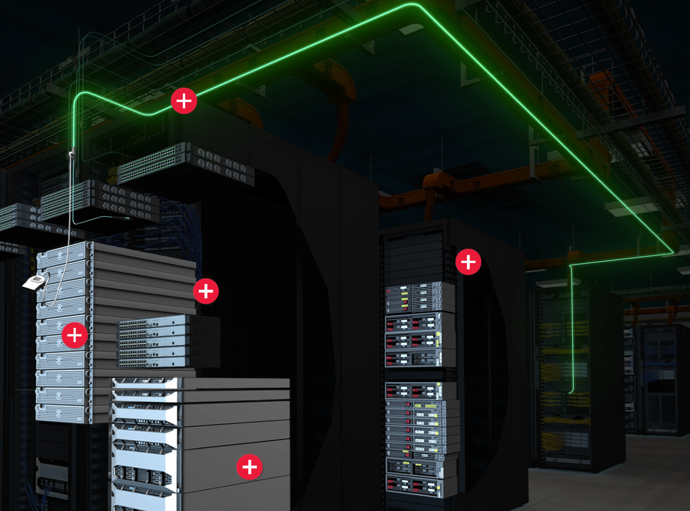
LumaLink - Optical Trace Cable Assembly
Construction
Identification
Tracing capability
Testing and troubleshooting
Documentation and maintenance
Overall, optical trace cable assemblies provide a practical solution for locating and identifying specific fibers within a fiber optic network, making network management, testing, and troubleshooting more efficient and accurate.
21
Notes:
An optical trace cable assembly, also known as an optical tracing cable or fiber optic tracer, is a specialized fiber optic cable assembly used for identifying and tracing specific fibers within a larger fiber optic network. It is typically used in situations where there is a need to locate and identify specific fibers in complex or crowded fiber optic installations.
Here are some key features and uses of optical trace cable assemblies:
1. Construction: An optical trace cable assembly consists of a standard fiber optic cable with additional elements that enable tracing and identification. These elements can include unique colors, patterns, or markings on the cable jacket, or specialized connectors that are easily distinguishable from standard connectors.
2. Identification: Optical trace cable assemblies are designed to be easily identifiable among other cables in the network. The unique colors or markings on the cable jacket help technicians quickly locate and visually distinguish the traced fibers from the rest of the fibers in the network.
3. Tracing capability: Optical trace cable assemblies allow technicians to trace specific fibers within a larger fiber optic network. This is particularly useful in situations where there are numerous fibers in a cable bundle or when dealing with complex network configurations. The traced fibers can be easily followed and identified throughout the network.
4. Testing and troubleshooting: Optical trace cable assemblies are valuable tools for testing and troubleshooting fiber optic networks. By tracing specific fibers, technicians can verify connectivity, confirm correct routing, and identify any faults or issues in the network.
5. Documentation and maintenance: Optical trace cable assemblies aid in maintaining accurate documentation of fiber optic networks. By using traced fibers, network documentation can be updated and maintained more efficiently, reducing errors and improving network management.
It's important to note that optical trace cable assemblies are typically customized or specially ordered to meet specific requirements. The unique identification features and tracing capabilities can be tailored to the needs of a particular network or installation.
Overall, optical trace cable assemblies provide a practical solution for locating and identifying specific fibers within a fiber optic network, making network management, testing, and troubleshooting more efficient and accurate

Slide 22
Racks and cabinets
Size and form factor
Mounting options
Cooling and ventilation
Cable management
Security
When selecting data center cabinets, it's important to consider factors such as equipment density, power requirements, cooling needs, cable management, and future scalability.
Proper planning and design of cabinets are crucial to ensure efficient and reliable operation of the data center infrastructure.
Power distribution
Modular and scalable design
Cable entry points
Rack accessories
22
Notes:
Data center cabinets, also known as server cabinets or racks, are specialized enclosures designed to house and organize network equipment, servers, and other IT infrastructure components in a data center environment. These cabinets provide a secure and controlled environment for the equipment, ensuring proper airflow, cable management, and physical security.
Here are some key features and considerations for data center cabinets:
1. Size and form factor: Data center cabinets come in various sizes and form factors, typically measured in rack units (U). The most common sizes are 42U and 45U, but cabinets can range from smaller sizes like 6U or 12U to larger sizes like 52U or more. The size of the cabinet depends on the amount of equipment it needs to accommodate.
2. Mounting options: Cabinets can support different mounting options, such as front or rear mounting, as well as adjustable rails for flexible equipment installation. Cabinets may also have additional features like slide-out or rotating rails for easier access to equipment during installation or maintenance.
3. Cooling and ventilation: Data center cabinets are designed to provide proper airflow and cooling to prevent equipment overheating. They typically have perforated front and rear doors, as well as optional fans, fans trays, or built-in cooling systems to ensure efficient airflow through the cabinet.
4. Cable management: Cabinets often include cable management features, such as cable trays, cable management rings, or vertical cable managers. These features help organize and route cables neatly, reducing cable clutter and improving airflow and maintenance access.
5. Security: Cabinets offer physical security for the equipment housed within them. They can have lockable doors, side panels, and access policies to restrict unauthorized access. Cabinets may also have built-in sensors or alarms to detect and alert in the event of tampering or unauthorized access attempts.
6. Power distribution: Cabinets may include power distribution units (PDUs) for efficient power management and distribution to the equipment. PDUs can provide power monitoring, remote power control, and surge protection features.
7. Modular and scalable design: Some cabinets have a modular design, allowing for easy expansion or reconfiguration of the cabinet as the data center's needs evolve. Modular cabinets can accommodate additional shelves, drawers, or accessories to support future equipment requirements.
8. Cable entry points: Cabinets typically have multiple cable entry points, such as top, bottom, or rear, to allow for easy cable routing and connectivity to the equipment.
9. Rack accessories: Various rack accessories, such as shelves, drawers, cable management panels, or blanking panels, can be added to cabinets to optimize storage, organization, and airflow management within the cabinet.
When selecting data center cabinets, it's important to consider factors such as equipment density, power requirements, cooling needs, cable management, and future scalability. Proper planning and design of cabinets are crucial to ensure efficient and reliable operation of the data center infrastructure.

Slide 23

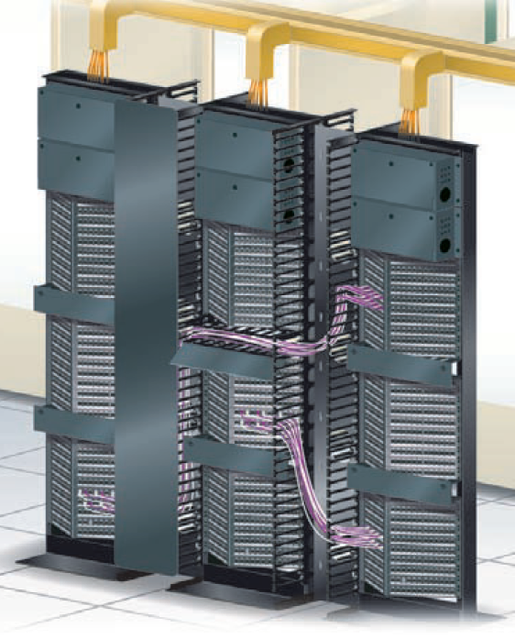
Vrm - Vertical cable organizers
Cable Organization
Improved Airflow
Easy Access and Maintenance
Aesthetics and Safety
When implementing vertical cable management, it's important to consider factors such as the quantity and types of cables, the layout of the rack or cabinet, and the specific needs of the network infrastructure. Utilizing cable management accessories such as vertical cable managers, cable rings, or cable trays can help achieve an efficient and effective vertical cable management system.
Consulting with cabling professionals or data center experts can provide valuable insights and guidance for implementing vertical cable management in your specific environment.
Flexibility
Cable Protection
23
Notes:
Vertical cable management is a crucial component of organizing and managing cables in data centers or server rooms. It involves the use of various tools and techniques to route and organize cables along the vertical space within racks or cabinets. Here are some key aspects and benefits of vertical cable management:
1. Cable Organization: Vertical cable management helps to keep cables organized and separated, reducing the risk of tangling or accidental disconnections. It allows for neat and orderly routing of cables from the patch panels or network switches to the equipment or servers within the rack.
2. Improved Airflow: Proper vertical cable management ensures that cables are routed away from the front and rear of the equipment, allowing for unobstructed airflow. This helps to maintain optimal cooling within the rack, reducing the risk of overheating and improving the performance and lifespan of the network equipment.
3. Easy Access and Maintenance: Well-implemented vertical cable management provides clear pathways for accessing and maintaining the equipment within the rack. It allows for easy identification and tracing of cables, simplifying troubleshooting and minimizing downtime.
6. Aesthetics and Safety: Proper cable management improves the overall appearance of the data center or server room, giving it a professional and organized look. It also reduces the risk of tripping hazards by keeping cables off the floor and out of walkways.
5. Scalability and Flexibility: Vertical cable management systems are designed to accommodate a range of cable sizes and quantities. They can be easily adjusted or expanded to accommodate future growth or changes in the network infrastructure.
4. Cable Protection: Vertical cable management solutions such as cable managers, vertical cable trays, or ducts help to protect cables from damage or accidental disconnections. They provide physical support and prevent excessive bending or strain on the cables, ensuring their longevity and reliability.
When implementing vertical cable management, it's important to consider factors such as the quantity and types of cables, the layout of the rack or cabinet, and the specific needs of the network infrastructure. Utilizing cable management accessories such as vertical cable managers, cable rings, or cable trays can help achieve an efficient and effective vertical cable management system. Consulting with cabling professionals or data center experts can provide valuable insights and guidance for implementing vertical cable management in your specific environment.

Slide 25
Cabling designing for data center
30min

Slide 26
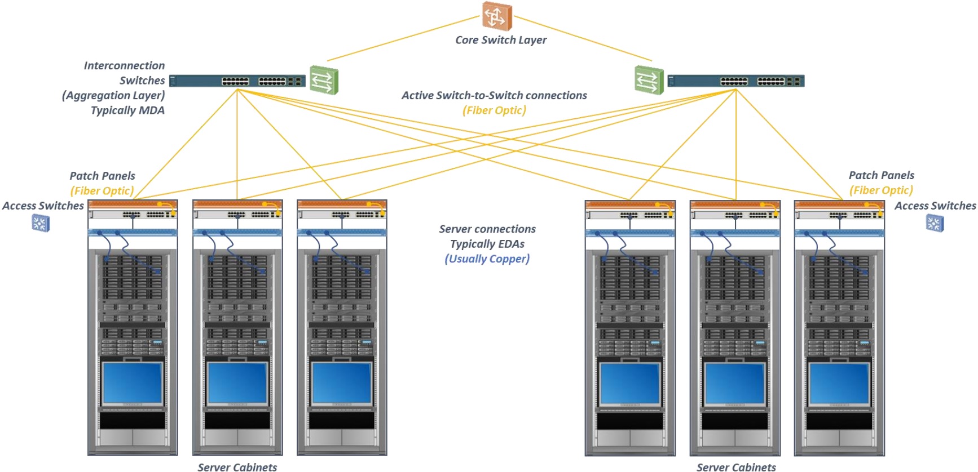
By considering these factors, you can design a cabling infrastructure that meets the specific needs of the data center, ensures high performance, and allows for future growth and flexibility.
What should be considered when designing cabling for a data center?
Bandwidth requirements
Cable type
Cable density
Scalability
Cable routing
Cable length
Cable labeling and documentation
Cable redundancy
Cable management
Compliance and standards
Notes:
When designing cabling for a data center, several factors should be considered:
1. Bandwidth requirements: Determine the current and future bandwidth needs of the data center to choose cables that can support the required data transfer rates.
2. Cable type: Select the appropriate cable type based on the specific requirements of the data center, such as copper or fiber optic cables. Fiber optic cables are generally preferred for their higher bandwidth and longer transmission distances.
3. Cable density: Consider the number of cables that need to be accommodated in the data center and plan for sufficient cable density. This includes selecting the appropriate cable management systems and racks to organize and support the cables.
4. Scalability: Design the cabling infrastructure with scalability in mind, allowing for future expansion and the addition of new equipment or technologies.
5. Cable routing: Plan the routing of cables to minimize interference, ensure proper airflow, and reduce the risk of accidental damage. Separate power and data cables to avoid electromagnetic interference.
6. Cable length: Determine the maximum cable lengths needed for each connection and ensure that the chosen cables can meet these requirements. Excessive cable lengths can lead to signal degradation.
7. Cable labeling and documentation: Implement a clear labeling system for cables to facilitate troubleshooting and maintenance. Document the cabling layout and keep it up to date for future reference.
8. Cable redundancy: Consider implementing redundant cabling paths to ensure high availability and minimize downtime in case of cable failures.
9. Cable management: Plan for proper cable management, including cable trays, racks, and patch panels, to keep cables organized, easily accessible, and minimize cable congestion.
10. Compliance and standards: Ensure that the cabling design complies with industry standards and regulations, such as TIA/EIA and ISO/IEC standards, to maintain compatibility and interoperability with other equipment and systems.
By considering these factors, you can design a cabling infrastructure that meets the specific needs of the data center, ensures high performance, and allows for future growth and flexibility.

Slide 27

Molex aims to be a trusted partner for customers in the design, installation, and servicing of data centers.
By providing comprehensive support, customization options, ongoing service, and future-proof solutions, Molex helps customers optimize the performance, efficiency, and reliability of their data center connectivity.
Design support
Installation support
Service and support
Customization and integration
Future-proofing and scalability
Global reach
Notes:
Molex, as a leading provider of connectivity solutions, offers a range of services and support to customers in designing, installing, and servicing data centers (DCs). Here are some ways Molex supports customers in these areas:
1. Design support: Molex provides design support to customers during the planning and design phase of their data center projects. This includes collaborating with customers to understand their specific requirements and challenges, and offering expert guidance on selecting the right connectivity solutions, such as fiber optic cables, connectors, and patch panels, based on their needs. Molex also offers design tools, resources, and technical documentation to assist in the design process.
2. Installation support: Molex offers installation support to ensure a smooth and efficient deployment of connectivity solutions within data centers. This includes providing installation guidelines, best practices, and training resources to help customers properly install and terminate fiber optic cables, connect and configure network components, and ensure optimal performance and reliability. Molex may also provide on-site support or collaborate with authorized installation partners to assist with installation if required.
3. Service and support: Molex offers ongoing service and support to customers to address any issues or challenges they may encounter with their data center connectivity solutions. This includes technical support through dedicated customer service teams, online resources, and troubleshooting guides. Molex also provides warranty coverage and replacement services for its products, ensuring customers have access to reliable support throughout the lifecycle of their data center infrastructure.
4. Customization and integration: Molex understands that each data center has unique requirements and configurations. As such, Molex offers customization options to tailor connectivity solutions to specific customer needs. This can include custom cable assemblies, connectors, or other components designed to integrate seamlessly within the customer's data center environment. Molex's engineering and design teams work closely with customers to develop and deliver customized solutions that meet their exact specifications.
5. Future-proofing and scalability: Molex is committed to helping customers future-proof their data center infrastructure and ensure scalability. Molex offers solutions that support higher data speeds, increased bandwidth, and evolving industry standards. This enables customers to adapt and upgrade their data center connectivity as their requirements change or technology advances, minimizing disruptions and maximizing the longevity of their investments.
6. With design and manufacturing facilities and sales teams around the world, we are able to draw on global market intelligence to develop products to meet the needs of tomorrow, today.
Overall, Molex aims to be a trusted partner for customers in the design, installation, and servicing of data centers. By providing comprehensive support, customization options, ongoing service, and future-proof solutions, Molex helps customers optimize the performance, efficiency, and reliability of their data center connectivity.

Slide 28

CUSTOMER SUPPORT PORTAL (CSP)
TICKETS
TOOLS
DOCUMENTS
BA, TRAINING & WARRANTY
CONSULTANTS &
DESIGNERS
TECHNICAL
BULLETINS
EDUCATION
NEWS FEED
LECTURE SERIES
TRAINING COURSES
INDUSTRY UPDATES
INCREASE YOUR KNOWLEDGE
Notes:
One way to support customers in the process of designing, installing and servicing cabling for data centers is through a Molex support portal.
1. The key function of CSP is to enable you to become a Business Associate (either CI or SI), renew your existing Business Associate status, take training, or apply for a warranty. The forms to do these are all accessed either through the "Forms" menu at the top of the CSP screen or by using the "Fast Access" buttons across the top of the homescreen.
The forms you can access from here are:
Business Associate
Training
Warranty Application
Helpdesk
MIIM Registration
2. We provide a complete set of tools primarily aimed at Consultants and Designers who wish to specify Molex in their bids and create BoM's easily.
There is everything here from Proposal Generators through to Site Overview Survey tools (an extremely useful one!) and part number generators and decoders.
3. We aim to provide documentation of value to assist installers to do their jobs well and ensure they comply with all Standards and best practices, and minimise their chances of any issues with Warranty submissions. Technical Bulletins are a great resource to achieve this.
4. The CSP is our primary method of delivering training. Training access is granted by completing a Training Request form for the desired course. A complete guide to all our courses is available directly from the CSP homepage.
5. We work hard to keep you up to date with anything you might be interested in via our news feed.
6. We offer access to lectures that discuss in detail selected issues in the field of structured cabling. You may be particularly interested in the topic of polarization in MPO connections or PoE issues.

Slide 29
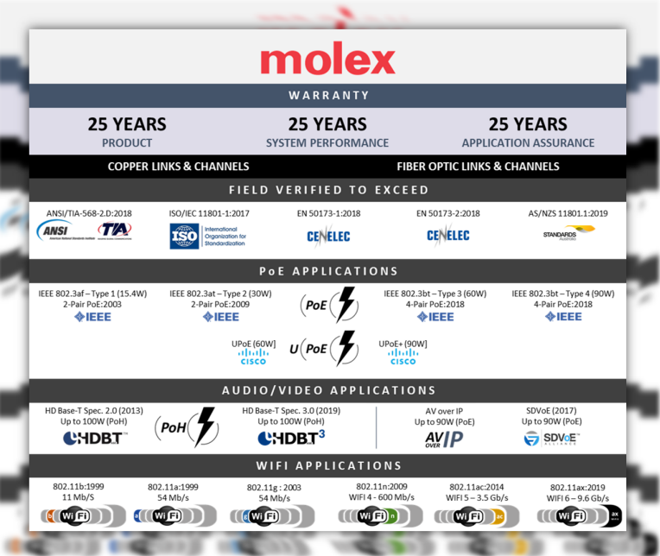
warranty
Molex's mission is to provide comprehensive copper and fiber solutions that ensure the integrity of your data
Notes:
As I mentioned earlier, one of the elements of our support is the warranty program.
A structured cabling warranty is important for several reasons. Firstly, it provides assurance and peace of mind to the customer that the cabling installation has been done correctly and meets industry standards. It guarantees that the cabling system will perform reliably and efficiently for a specified period of time.
Secondly, a warranty ensures that any potential issues or defects in the cabling system will be addressed and resolved by the manufacturer or installer at no additional cost to the customer. This can save both time and money in the event of any unforeseen problems.
Warranties can be claimed by Certified Installers, who must periodically renew Molex training courses to keep them up to date with current standards, products and installation practices.
Overall, a structured cabling warranty provides a level of protection and support for the customer, ensuring the reliability and longevity of their cabling infrastructure.
Molex offers a 25-year warranty program that covers products, system performance and support for network applications. It is also the only one in the market to offer warranty support for AV, PoE and WiFi applications.

Slide 31
Cabinet Enviromental monitoring and access control
20min
Notes:
I would like to present Molex solutions for environmental parameter control and access control for cabinets.

Slide 32

Incorporating comprehensive environmental monitoring systems into your data center cabinets helps maintain optimal conditions for equipment operation, prevent downtime, and protect sensitive data and infrastructure. It also contributes to energy efficiency and reduces the risk of equipment damage.
Temperature and Humidity Monitoring
Airflow and Ventilation
Power Consumption
Security
Water Leak Detection
Fire Detection
Remote Monitoring and Control
Alerting and Reporting
Integration with Building Management System (BMS)
Regular Maintenance
Redundancy
Compliance
Scalability
Notes:
Environmental monitoring of data center cabinets is crucial to ensure the proper functioning and safety of the equipment housed within them. Here are some key aspects of environmental monitoring for data center cabinets:
Temperature and Humidity Monitoring:
Temperature Sensors: Place temperature sensors inside the cabinet to monitor the internal temperature. Ensure they are accurate and calibrated regularly.
Humidity Sensors: Install humidity sensors to monitor humidity levels within the cabinet. This helps prevent condensation and equipment damage.
Alerting: Set up automated alerts for temperature and humidity thresholds. If conditions deviate from acceptable ranges, you should receive notifications in real-time.
Airflow and Ventilation:
Airflow Sensors: Use airflow sensors to monitor the circulation of air within the cabinet. Ensure that hot air is effectively exhausted, and cold air is distributed to maintain ideal equipment temperatures.
Fan Control: Implement fan control systems that automatically adjust fan speed based on temperature and airflow data to optimize cooling.
Power Consumption:
Power Monitoring: Install power monitoring equipment to track power consumption within the cabinet. This helps in capacity planning and energy efficiency efforts.
Power Distribution Units (PDUs): Use intelligent PDUs with monitoring capabilities to track power usage and remotely control power to individual devices.
Security:
Door Sensors: Install door sensors to detect unauthorized access to the cabinet. These sensors can trigger alarms or send alerts in case of tampering.
Locking Mechanisms: Ensure cabinets have secure locking mechanisms to prevent physical breaches.
Water Leak Detection:
Place water leak sensors at the base of cabinets to detect any water intrusion. This is critical for preventing damage to equipment in case of leaks or flooding.
Fire Detection:
Integrate smoke detectors or fire suppression systems as needed to ensure early detection and rapid response to fire incidents within the cabinet.
Remote Monitoring and Control:
Utilize remote monitoring systems that allow you to access and control cabinet parameters from a central location. This enables quick response to environmental issues.
Alerting and Reporting:
Configure alerting mechanisms to notify data center staff or administrators when environmental conditions deviate from acceptable ranges.
Generate regular reports on cabinet conditions for compliance and performance analysis.
Integration with Building Management System (BMS):
Integrate cabinet-level environmental monitoring with the overall data center's BMS for centralized control and coordination.
Regular Maintenance:
Schedule routine maintenance to calibrate sensors, replace batteries in monitoring devices, and ensure the continued reliability of the monitoring system.
Redundancy:
Consider redundant sensors and monitoring equipment to ensure that environmental data is continuously collected even in the event of sensor failures.
Compliance:
Ensure that your environmental monitoring system complies with relevant industry standards and regulations, such as those related to data center operations and environmental controls.
Scalability:
Plan for the scalability of your environmental monitoring system as your data center grows. Ensure that it can accommodate additional cabinets and sensors.
Incorporating comprehensive environmental monitoring systems into your data center cabinets helps maintain optimal conditions for equipment operation, prevent downtime, and protect sensitive data and infrastructure. It also contributes to energy efficiency and reduces the risk of equipment damage.

Slide 33
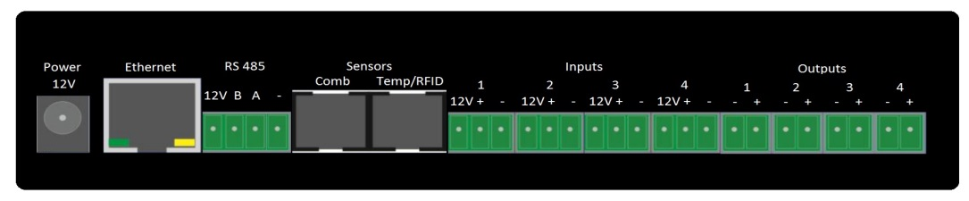
Ciim
Cabinet Intelligent Infrastructure Monitoring controler
Communication using Ethernet (100Base –TX) standard.
4x analogue inputs with 12V supply for sensors and sabotage detection
4x 12V outputs for direct driving peripheral devices.
Sensors: 2 sockets for digital interface temperature, temperature & humidity (combo) and pressure sensors, support of other sensors with binary output.
Access control: support for proximity access card readers (RFID) operating in UNIQUE,MIFARE, HID or HITAG standard.
Dedicated alarm section triggered by inputs state or/and temperature/humidity value.
Ability to semi-automatically change output state depending on configurable set of rules.
Dedicated software for managing group of devices with abilities for long term parameter monitoring and analysis
Notes:
The answer to these requirements is the CIIM system Cabinet Intelligent Infrastructure Monitoring for cabinets and data rooms infrastructure
The system is designed to control environmental parameters and access control for a single cabinet, thanks to which it allows easy scalability.
The heart of the system is the controller, to which sensors and external devices are connected. The controller has a built-in web server, which allows remote communication, making settings, reviewing events and sending notifications.
The controller also communicates with other systems using the SNMP protocol.
In the case of managing a larger number of cabinets, controllers via LAN are supported by dedicated DCIM software

Slide 34
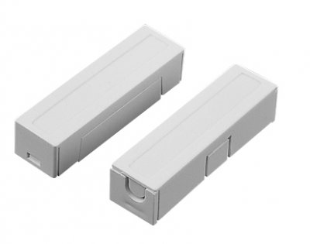
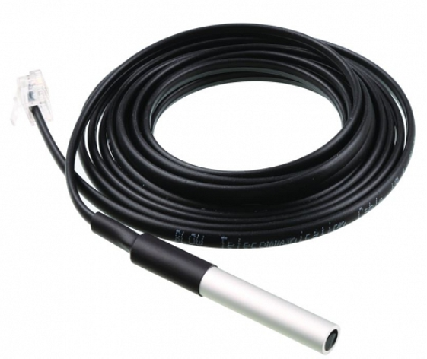
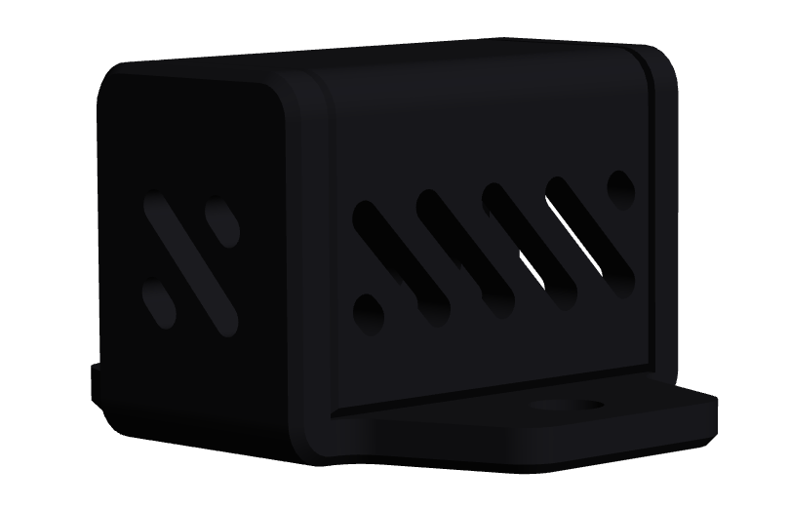
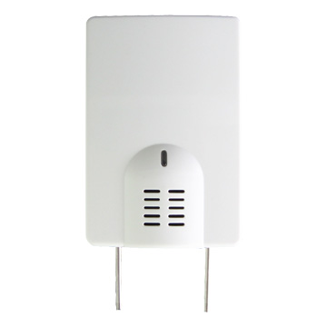
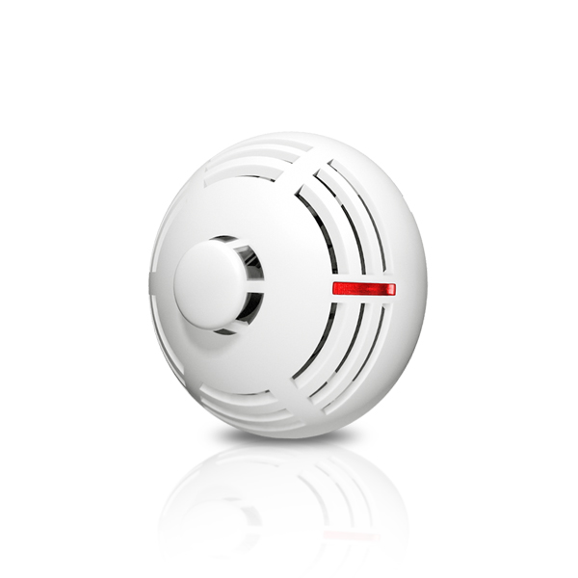
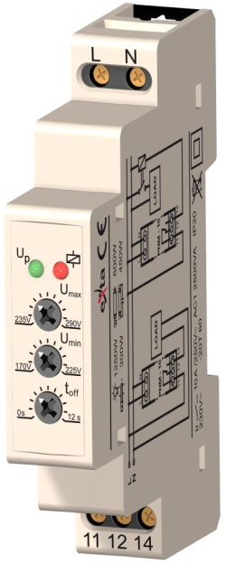






Ciim
Cabinet Intelligent Infrastructure Monitoring sensors
Door Contact
Temperature
Temperature and humidity
Pressure
Water
Fire
Power failure
…and many others
Notes:
All sensors are wired. Connection to the controller does not require termination - plug&play.

Slide 35
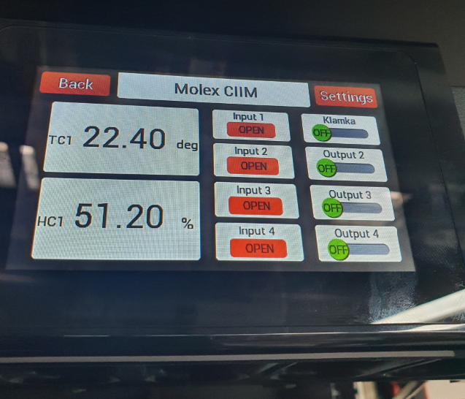
An electronic label uniquely identifying the cabinet in question,
On-screen keypad for user authentication via PIN code,
Message of the day - a message which is displayed to all logged-in users containing important information, e.g. technical or organizational information,
Control of central module outputs (e.g. opening cabinet doors),
Presenting the current value of temperature, humidity, status of inputs and outputs, Informs about alarms currently occurring inside the enclosure,
Allows the creation of temperature and humidity graphs.
Ciim
Cabinet Intelligent Infrastructure Monitoring
touch display
Notes:
An electronic label uniquely identifying the cabinet in question,
On-screen keypad for user authentication via PIN code,
Message of the day - a message which is displayed to all logged-in users containing important information, e.g. technical or organizational information,
Control of central module outputs (e.g. opening cabinet doors),
Presenting the current value of temperature, humidity, status of inputs and outputs, Informs about alarms currently occurring inside the enclosure,
Allows the creation of temperature and humidity graphs.

Slide 36
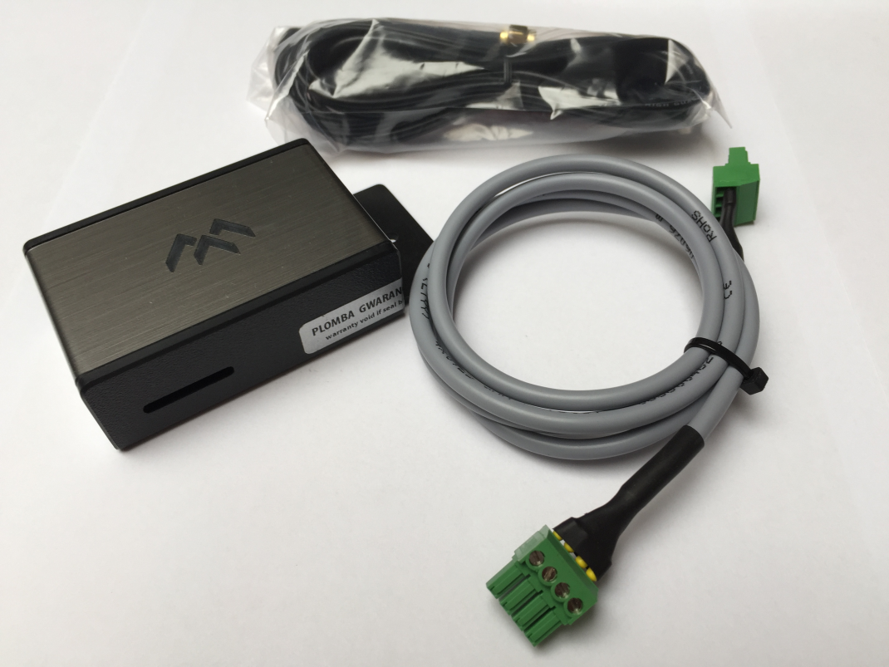
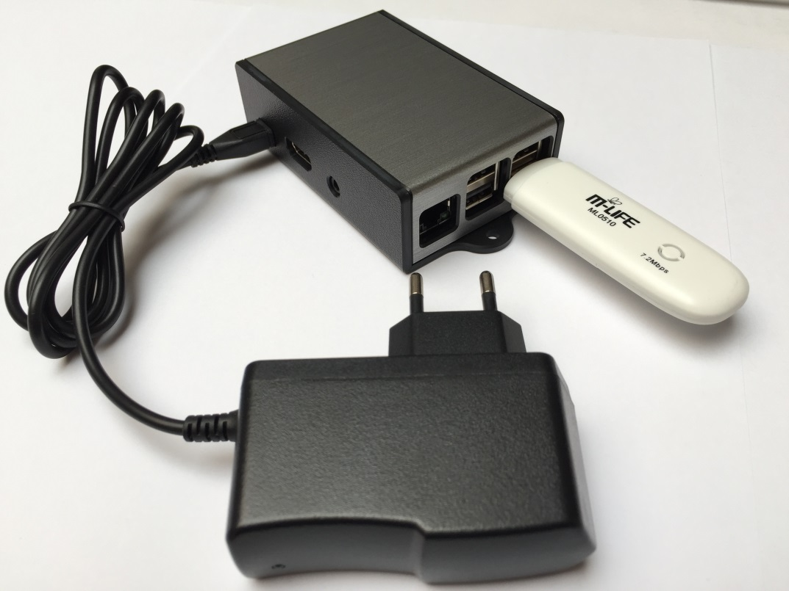
Ciim
Cabinet Intelligent Infrastructure Monitoring gsm modules
Local GSM module
Network GSM module
Notes:
To be able to send alarm notifications to cell phones, the system should be equipped with GSM modems.
Two versions are available. A local option, when notifications are sent from one controller, and a network version when notifications are sent from more controllers. Then the GSM modem requires connection to the network in which all controllers work.

Slide 37

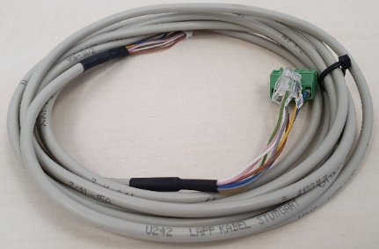
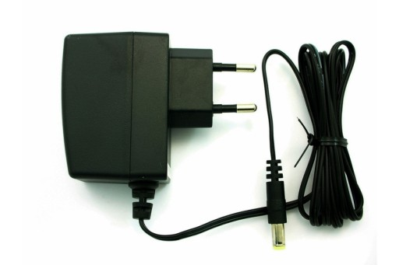

Ciim
Cabinet Intelligent Infrastructure Monitoring rfid handle
All-round compatibility with existing holes standards
Compatible with 1-point and 3-point locking
Emergency opening : customized key patterns
Opening mechanism based on servomotor (no electromagnet)
Stand-alone option (controler not required)
Electronic system
+
Notes:
All-round compatibility with existing holes standards
Electronic-ready : possibility of easy future upgrades
Compatible with 1-point and 3-point locking
Emergency opening : customized key patterns
Opening mechanism based on servomotor (no electromagnet)
Different key patterns available– individual, group, master key

Slide 38
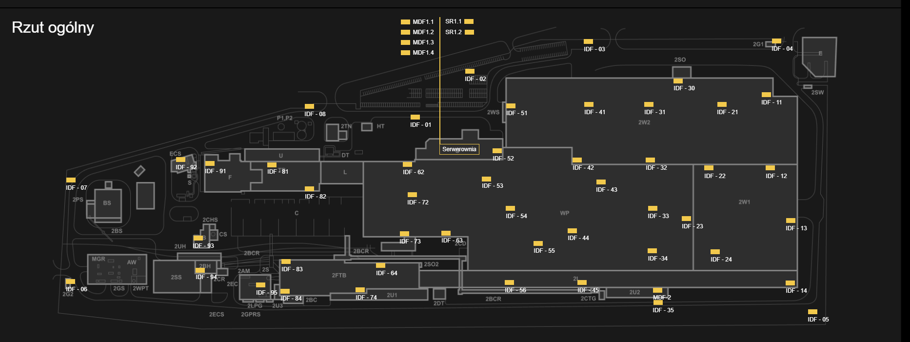
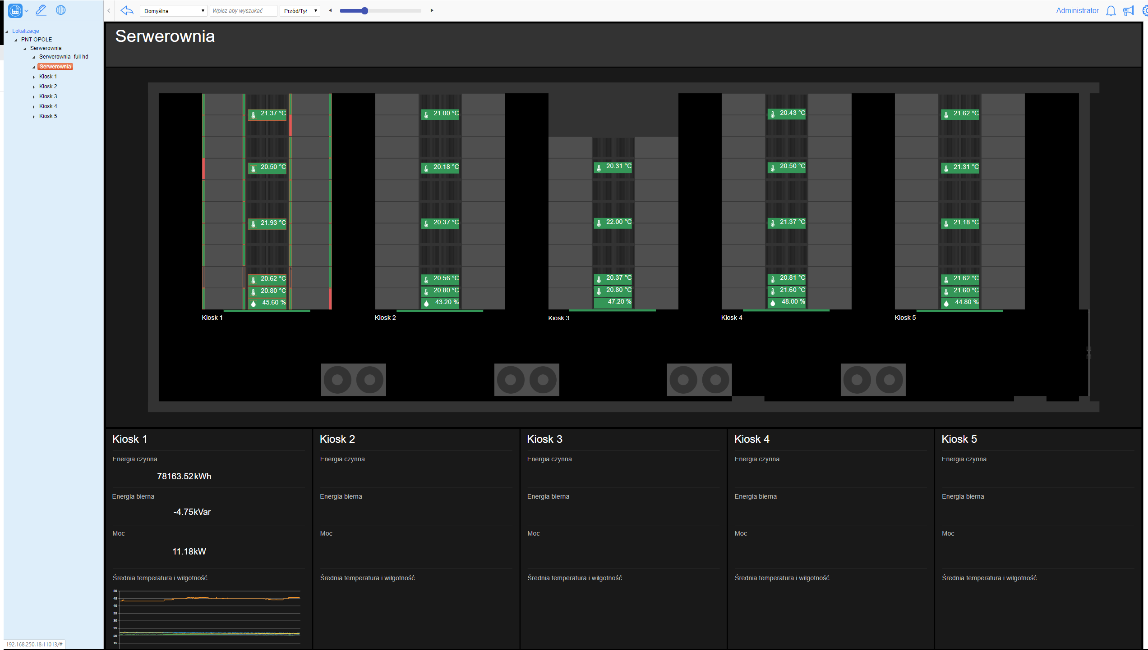
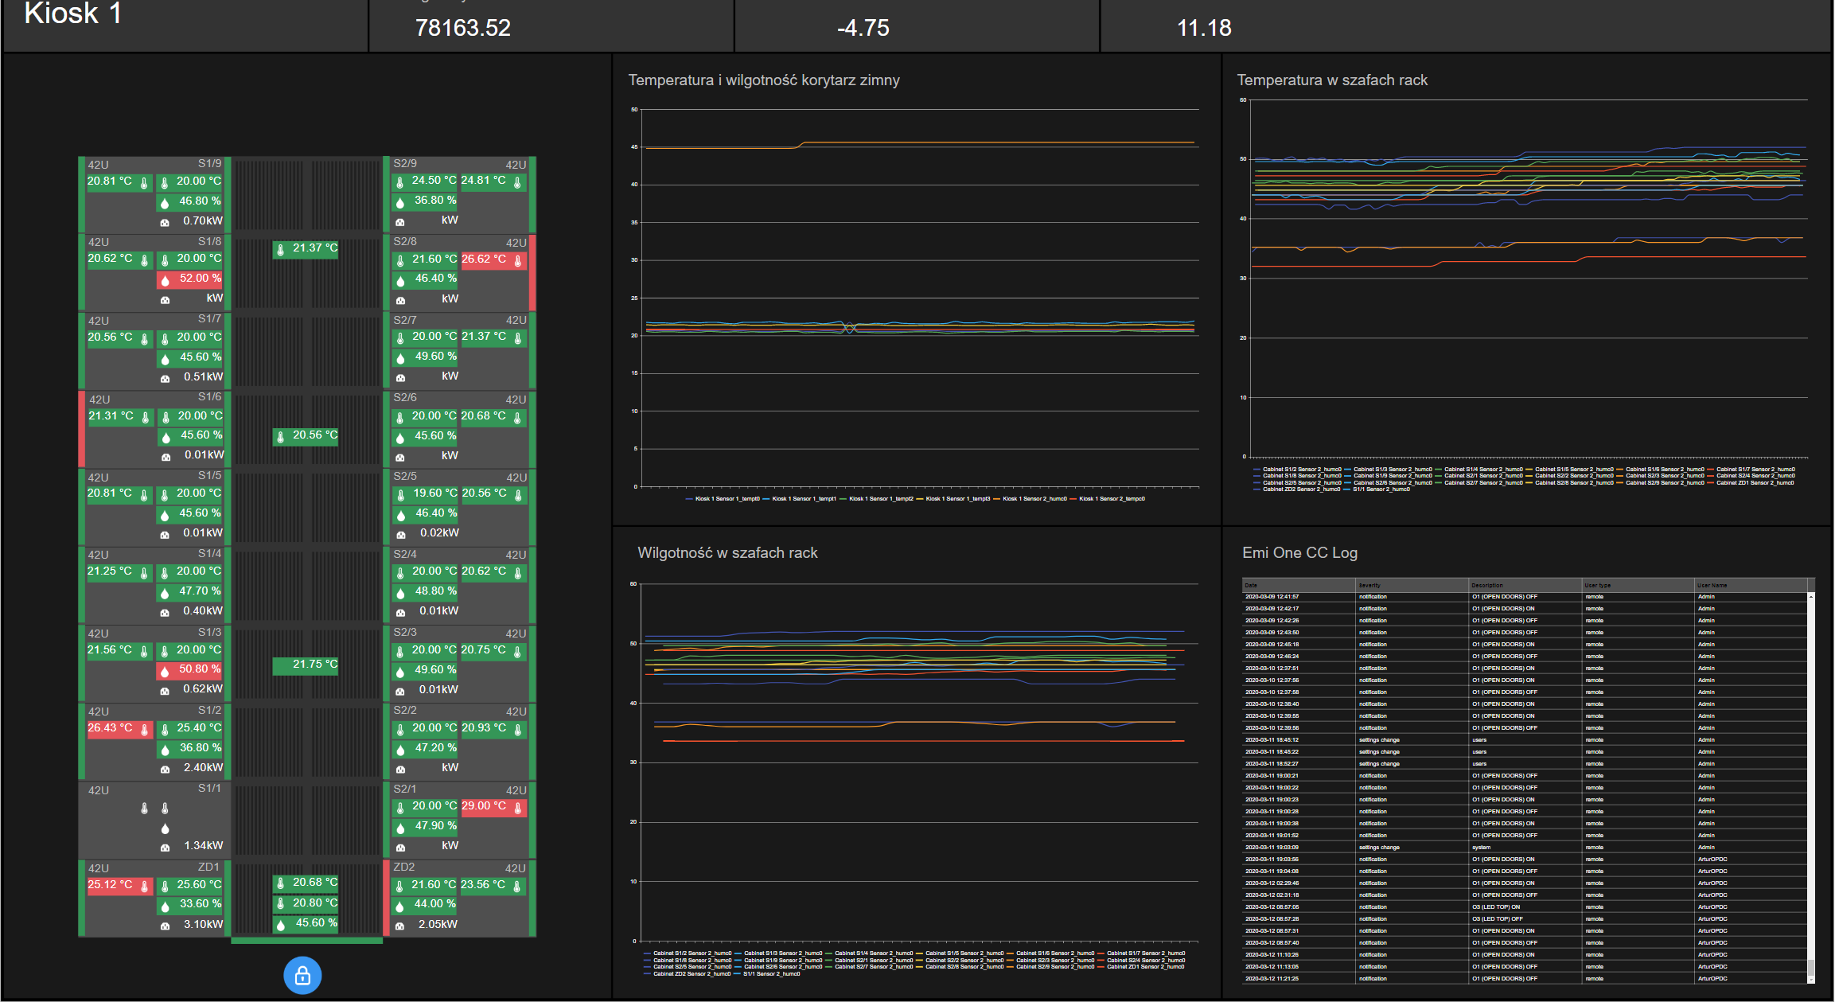
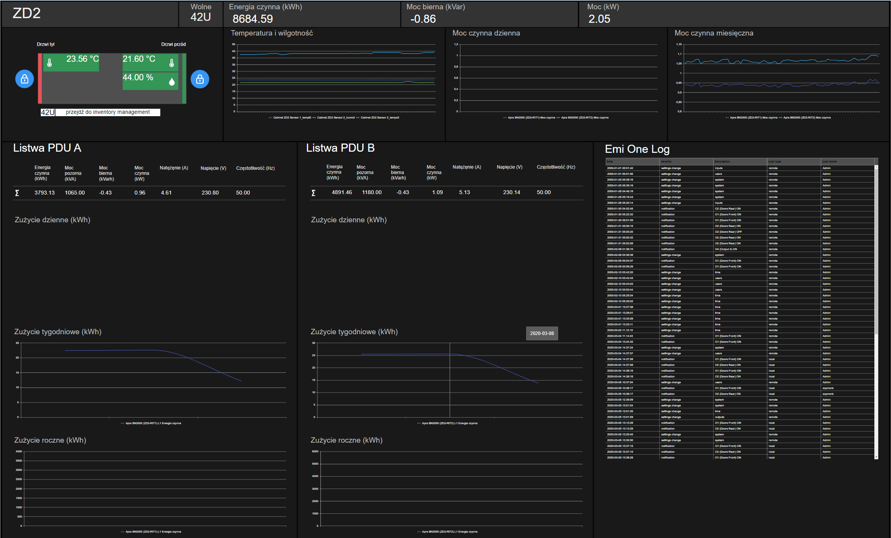
Ciim
Cabinet Intelligent Infrastructure Monitoring management software
Interactive room maps of actual Data Center
Fully customizable graphs of any measured values
Access control management – doors/locks status, users and rights management
PDU data visualization
Energy consumption reports for rack/corridor/room
Event LOG
Inventory and connection manager
Scalable licensing -> per Rack
Notes:
In a situation where you want to manage more controllers, accessing them through the built-in web server can be inefficient and time-consuming.
This is when DCIM software comes to the rescue.
A complete solution for environment monitoring, access control and power management for Data Centers.

