Slide 1
Innovative Technologies
in Data Center
Kehua Tech：Johnson

Slide 2
Data Center Challenges
High TCO for Traditional Data Center during lifespan
High energy consumption
Long construction time
Hard to O & M
100%
100%
40%
DC energy consumption in 2020~2030
18 reduce to 6~9 months
38%@2018,53%@2022
Decadal Energy Consumption Growth
Short TTM requirements
Growth rate of insufficient O&M engineer

Slide 3


WisePower Product Line
01
35+ Years Power Conversion Expert

Slide 4
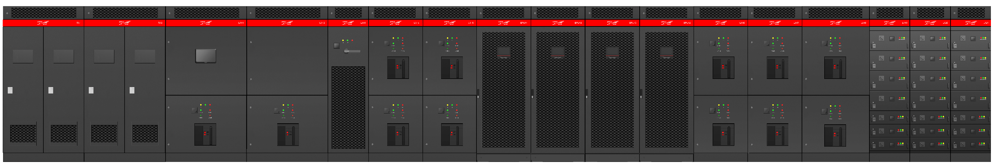
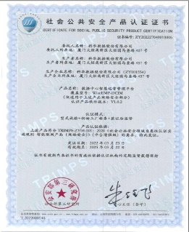
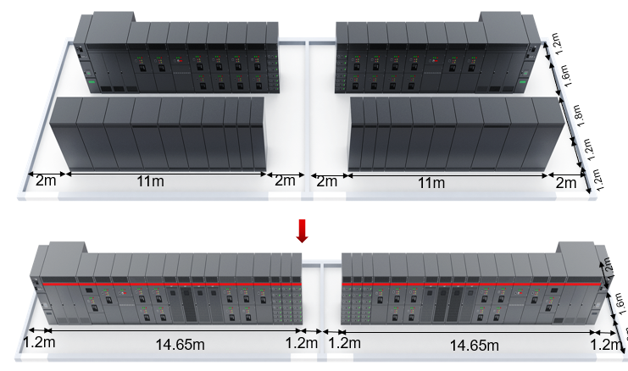
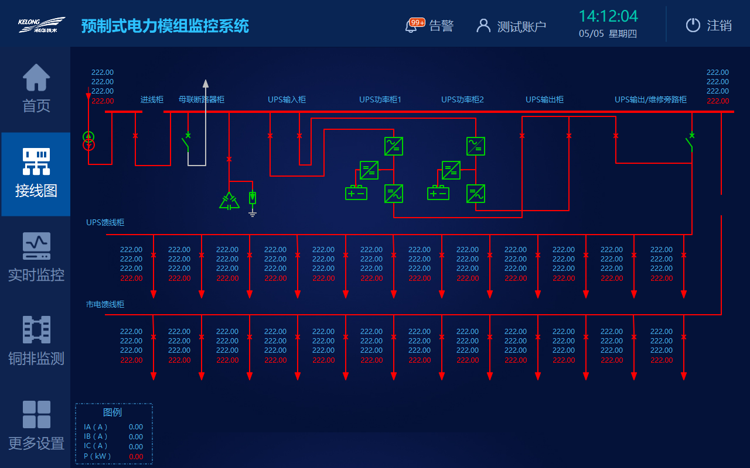
WisePower ——Integration Power solution
Reducing space and delivery time by 30%, and lowering PUE by 0.02
2.5MW Wise Power
云动力预制式电力模组
2.5MW Wise Power
2500kVA transformer
Inlet
Connected
SVG
UPS Input
4*600kVA UPS
Output
Bypass
Feeder
High reliability
Green low carbon
Convenient maintenance
Layout High Reliability
Highly Reliable Capacity
Component High Reliability
Highly reliable software
Deployment cycle time: -60%
Footprint: -30%
System efficiency: +2%
Convenient Inspection
Convenient management
Convenient update
Notes:
针对DC供备电的产品需求，科华结合自己对数据中心的理解，
融合从中压输入+变压器+UPS输入输出+UPS+低压分配单元+电力监控，
各单元在顶部采用母排连接，形成一个全新的整体解决方案：WisePower系列，
功率包含1.6MW~2.5MW；
对比传统供备电产品集成方案，
WisePower可节省部署时间60%；
节省占地面积30%
通过WECO模式，系统效率可提升2%

Slide 5
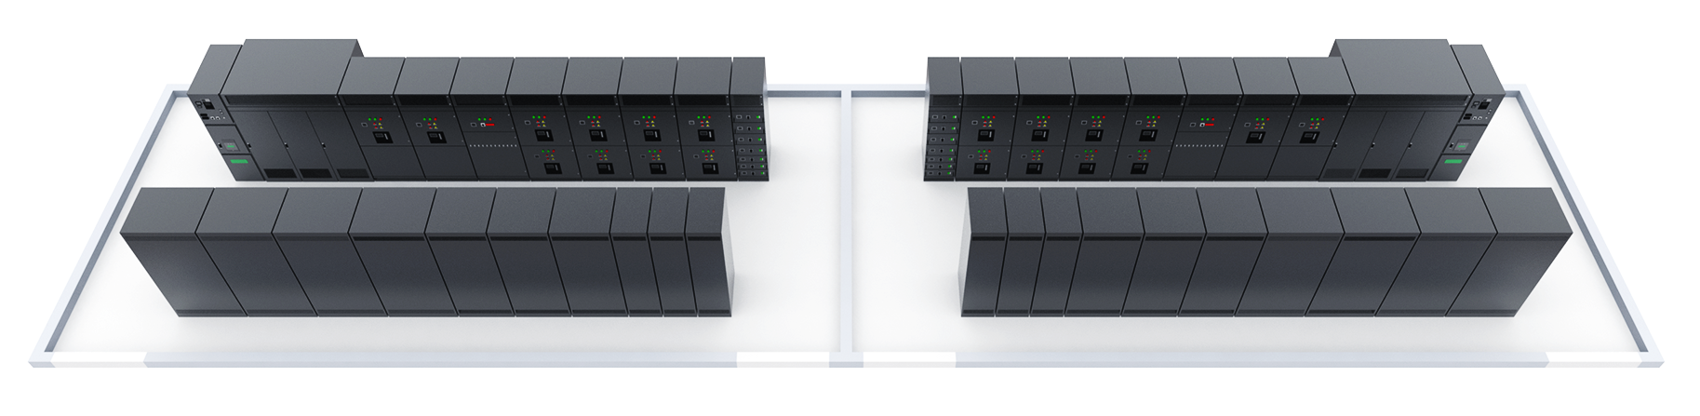
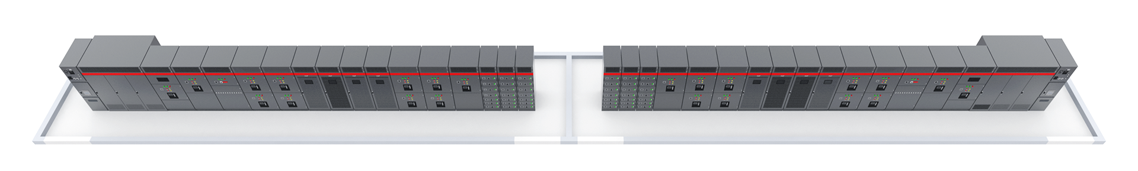
WisePower ——Integration Power solution
30% space saving for 30 server cabinets
1.2m
Tradition solution：
L=11+2+2=15m
W=1.2+1.2+1.8+1.6+1.2=7m
S=15m*7m=105m2
1.6m
1.8m
1.2m
2m
11m
2m
2m
11m
2m
1.2m
Wisepower solution：
L=14.65+1.2+1.2=17.05m
W=1.3+1.6+1.2=4.1m
S=17.05m*4.1m=69.905m2
1.2m
1.6m
1.3m
2 sets 2.5MW system footprint :70m²
Reduce 30%
Adding 30 racks
Adding >250,000USD/Year
1.2m
14.65m
1.2m
1.2m
14.65m
1.2m
Scenarios ：Tier Ⅳ，300 racks,6kW/rack，2 sets 2.5MW Wisepower

Slide 6
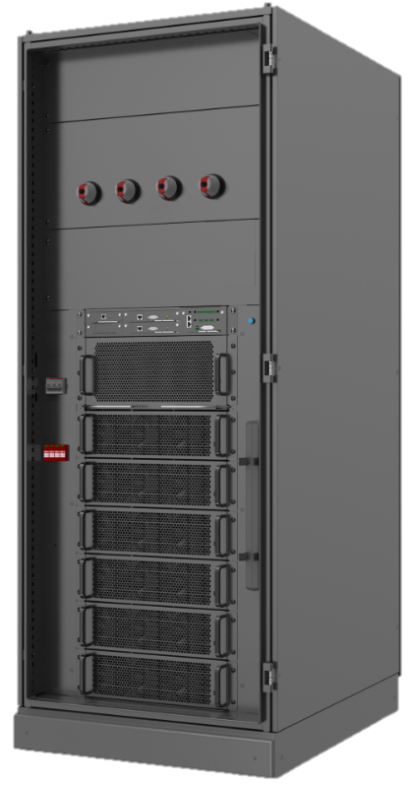
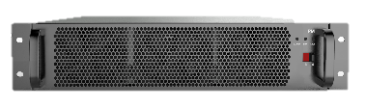
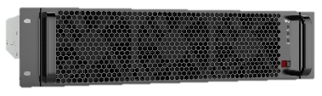
WisePower ——Modular UPS
High density design，one server cabinet 600KW，reduce 50% footprint
PM
600kVA
MR33
Reliable
Efficient
Conveni-ent
Smart
N+1/N+N Component redundancy
Full switch without adding dimension
30kW 2U
AI+
ESS mode
Sleep mode
Self-load test
Smart-dedust
99%(ECO)
97% (Online)
  2000mm
50kW 3U
100kW 3U
Front O&M
Installation against the wall
Top/bottom wiring
  1000mm
  800mm
Reliable, efficient, convenient, smart provide the most competitive product

Slide 7
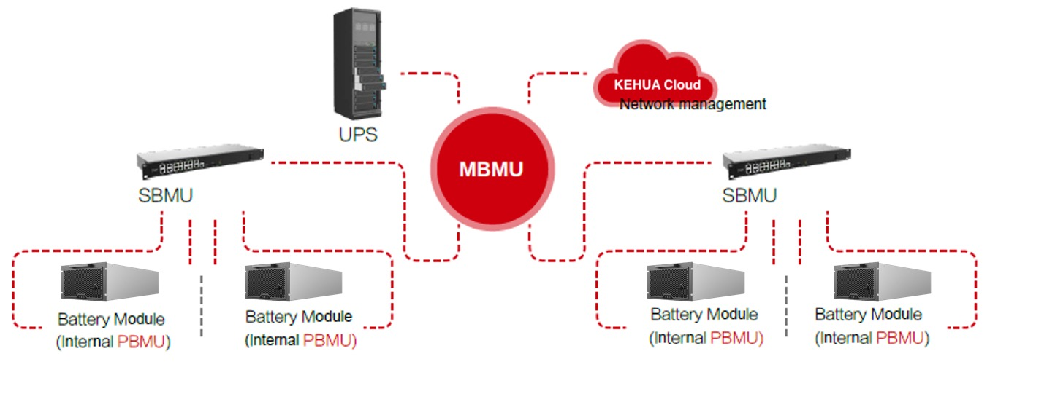
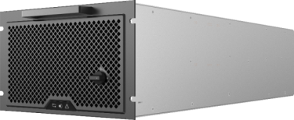
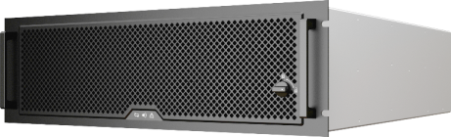

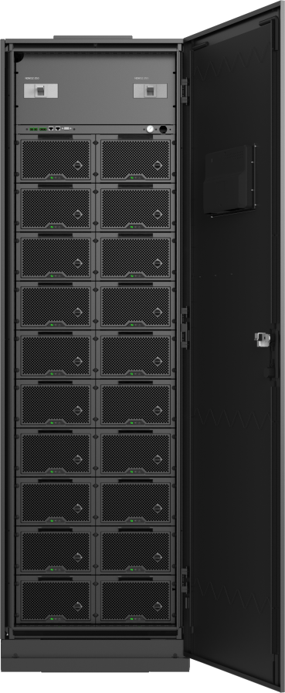
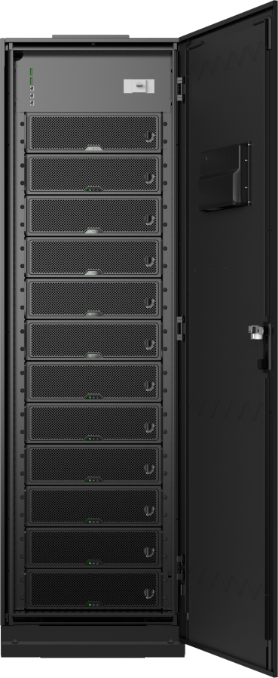
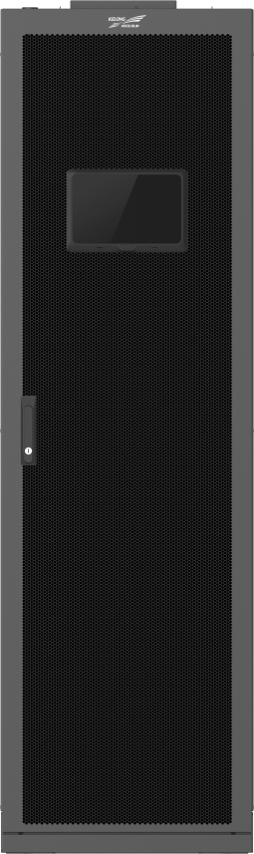
WisePower——Lithium-ion Battery System
>15 years life span, small footprint，reduce 45% TCO
40AH/50AH pack
100AH/1C pack
Appearance
DC/DC module
Electrical&physical isolation
Pack&cabinet insulation detection
Pack & cabinet FFS
AI Battery Management
Intelligent current equalization
Fault recording ,early warning
Adaptive SOC management
3 levels BMS architecture
Modular design
Hot-swap, Plug and play
Flexible for expansion
Smart battery test
Failure module exit automatically
40AH/50AH system
100AH/1C system

Slide 8
WiseCooling Product Line
02
35+ Years Power Conversion Expert

Slide 9
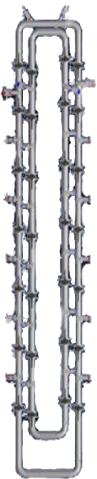
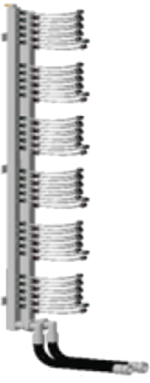
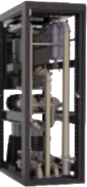
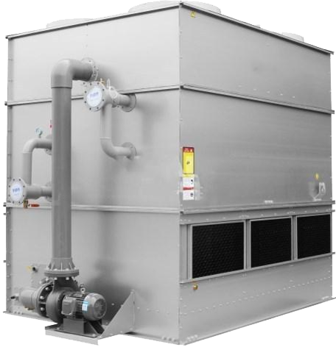
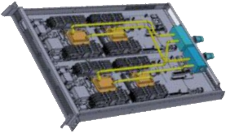




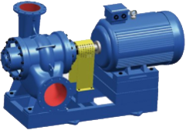

WiseCooling Product Line ——Liquid Cooling
Data centers with liquid cooling can reduce annual PUE to 1.16
Control System
Plate heat exchanger
（In&Out heat）
Secondary side
pump
Liquid cooling
server
Rapid
connection
Distribution
pipe
Primary side
pump
manifold
CDU
Cooling tower
Refrigerant
（deionized water/distilled water）
Notes:
针对未来DC高功耗的IT制冷，以及低PUE的需求，
科华拥有全链条的液冷产品解决方案，
上图是冷板式液冷的产品解决方案，包含：快速接头——manifold（（集水分歧管））——环形网管——CDU（Coolant Distribution Unit，冷量分配单元）——集成冷站
采用冷板式液冷解决方案，PUE可达到1.16
20MW数据中心：365*24*20*1000*0.3*0.7=5,110,000USD(5 million)
放视频

Slide 10
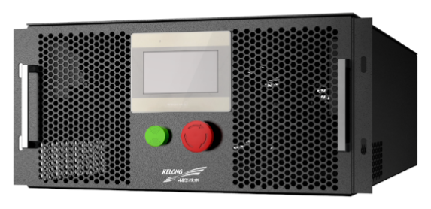
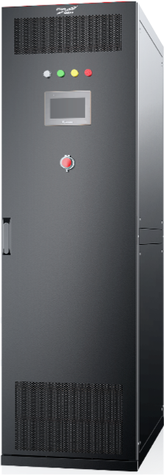
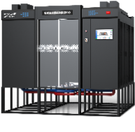
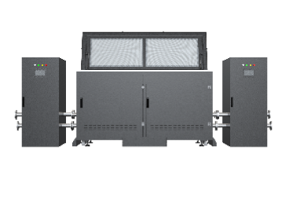
WiseCooling Product Line ——Liquid Cooling
High density design，rack power up to 60KW
DrawerCDU
Kehua Liquid
Cooling Family
Rack CDU
Liquid cooling
Micro module
Immersion
cooling
Cold Plate Liquid Cooling and Immersion Liquid Cooling technologies directly exchange heat for key server heat generating components to achieve temperature control effects and provide a low PUE, high power density green energy saving data center solution.
Notes:
根据不同功耗和场景需求，科华推出系列液冷产品，
包括：机架式CDU，机柜式CDU，液冷微模块集成产品方案，浸没式液冷集成产品方案；
从左图可以看出，制冷系统的功耗占非IT功耗的60%；
采用液冷可以有效降低PUE，节省TCO（total cost of ownership）,是未来IT演进一项优质的产品解决方案
展开

Slide 11
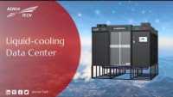

Slide 12
DCIM System
03
35+ Years Power Conversion Expert

Slide 13
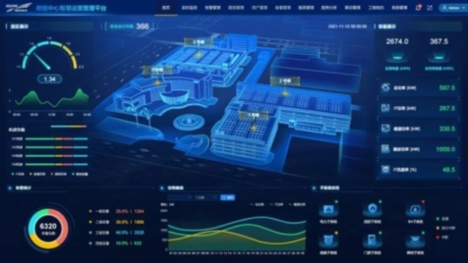
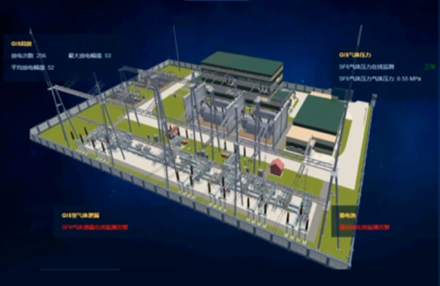
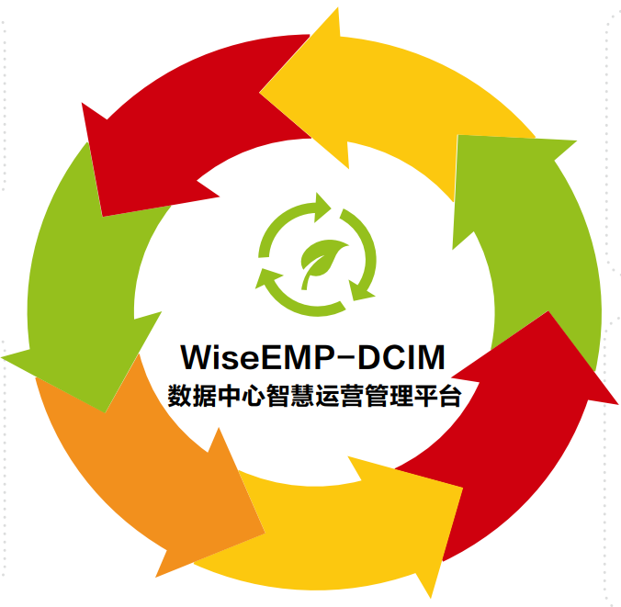
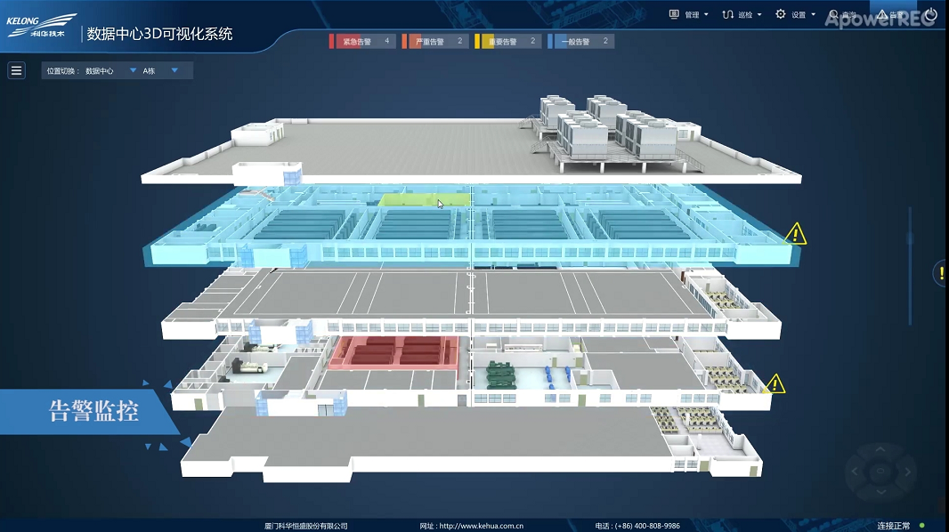
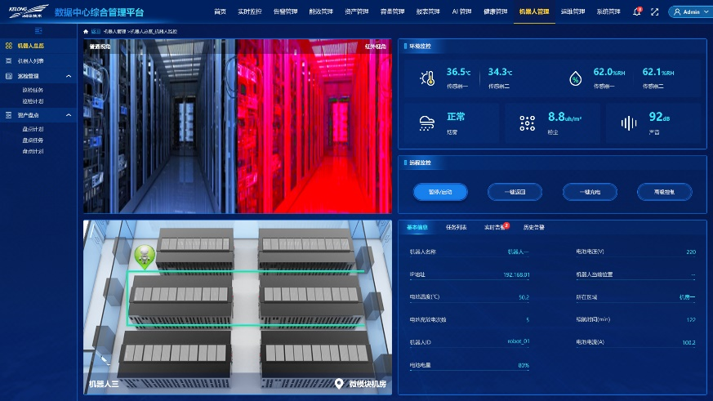
3-level Platform, 7-core Functions
WiseEMP-DCIM
"Intelligent Robot Inspection“
"Equipment and system health analysis“
"AI energy efficiency management"
DCIM+SCADA
3-level platform：building/compound/cloud
7-core functions：
Power & environmental monitoring
Operation and maintenance management
Asset management
Capacity Management
Energy Efficiency Management
Health Management
3D Visualization
Notes:
WiseEMP-DCIM数据中心智慧运营管理平台覆盖机房、园区、云平台的3级平台架构，核心功能有运维管理、资产管理、动环监控、容量管理、能效管理、3D可视化。
DCIM融合“智能机器人管理”、“健康度管理”（三级健康度管理：器件、设备、系统）、“AI管理”创新功能。

Slide 14

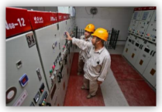
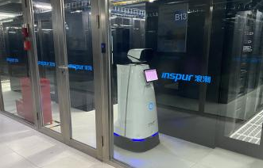

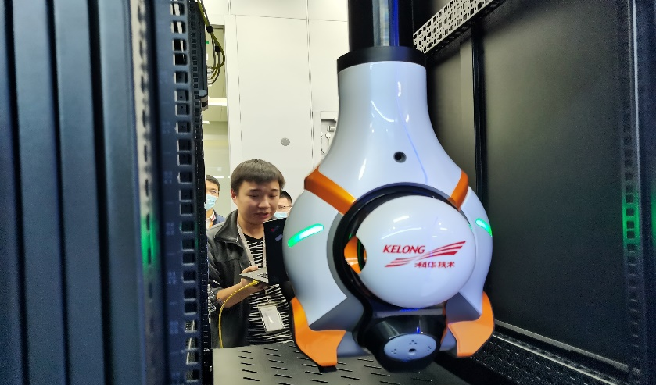

Digital Intelligent Inspection
Inspection efficiency is increased by more than 80%, and the average inspection time per cabinet is reduced to less than 10s.
Traditional inspection
Digital Intelligent Inspection
Passive monitoring: low degree of intelligence
Limitations： Influence of O&M personnel's physiological state, work experience, skill level, etc.
Low efficiency：It cost lots of labor and time
Active inspection：remote inspection, robot on-site inspection
Standard：Expert system to establish a standard digital inspection process and evaluation system
Auto-maintenance tool
Automated tasks
Standardized work
Digitized results
Inspection efficiency is increased by more than 80%, and the average inspection time per cabinet is reduced to less than 10s.
Notes:
巡检机器人方案替代传统人工巡检，智能化巡检，（高清摄像头，红外，热成像，温湿度，声控采集，升降），实现7*24小时黑灯数据中心运维。
产品解决方案已有成功应用案例

Slide 15
Prefabricated BLOCK DC
04
35+ Years Power Conversion Expert

Slide 16

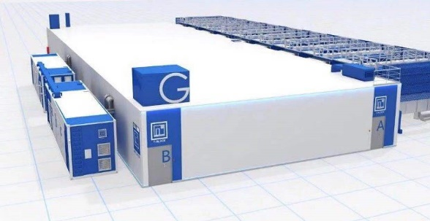
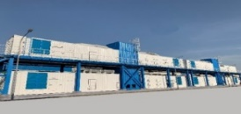
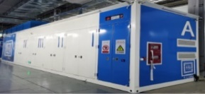
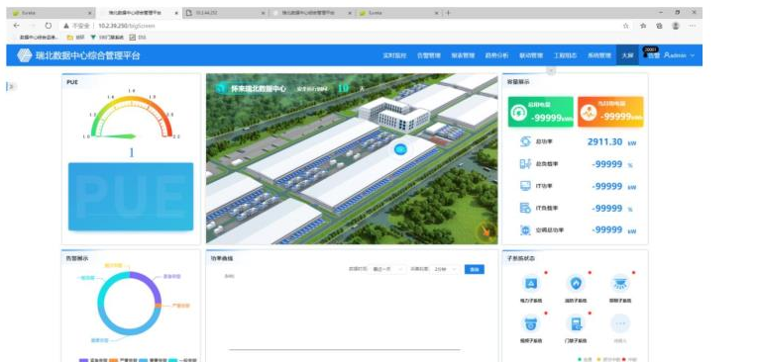
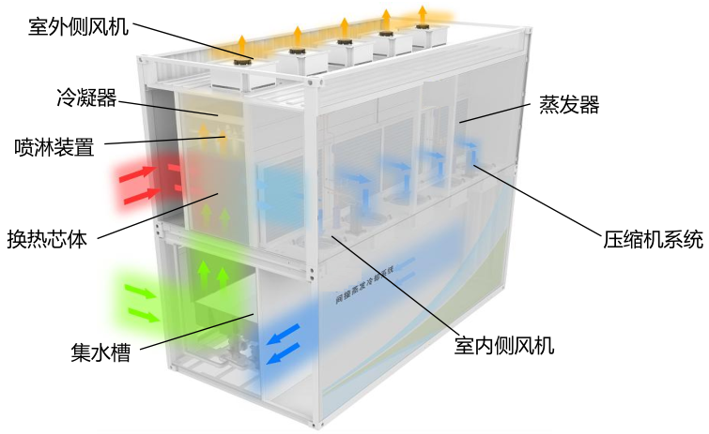
Pre-BLOCK Container
Kehua Data provides a clustered data center solution, which integrates the whole chain of diesel-fueled container, AHU air-conditioning container, power container, power supply container, IT container, and DCIM systems, to build a minimalist and green campus-based data center rapid delivery solution.
IT block
Clustered Data Center Solution Benefits
TTM: Simplified Delivery, Factory Prefabricated commissioning
Prefabrication：>60%
30% shorter TTM than traditional server room (1,000 cabinets)
PUE: wind-in-water-out, simple cooling, PUE<1.3 (South China)
TCO: Reduce TCO by about 20% compared to traditional server room TCO
Generator block
Power block
Monitoring
Air conditioner block
Notes:
BLOCK各个模块的组成
优势：
TTM
PUE
TCO

Slide 17
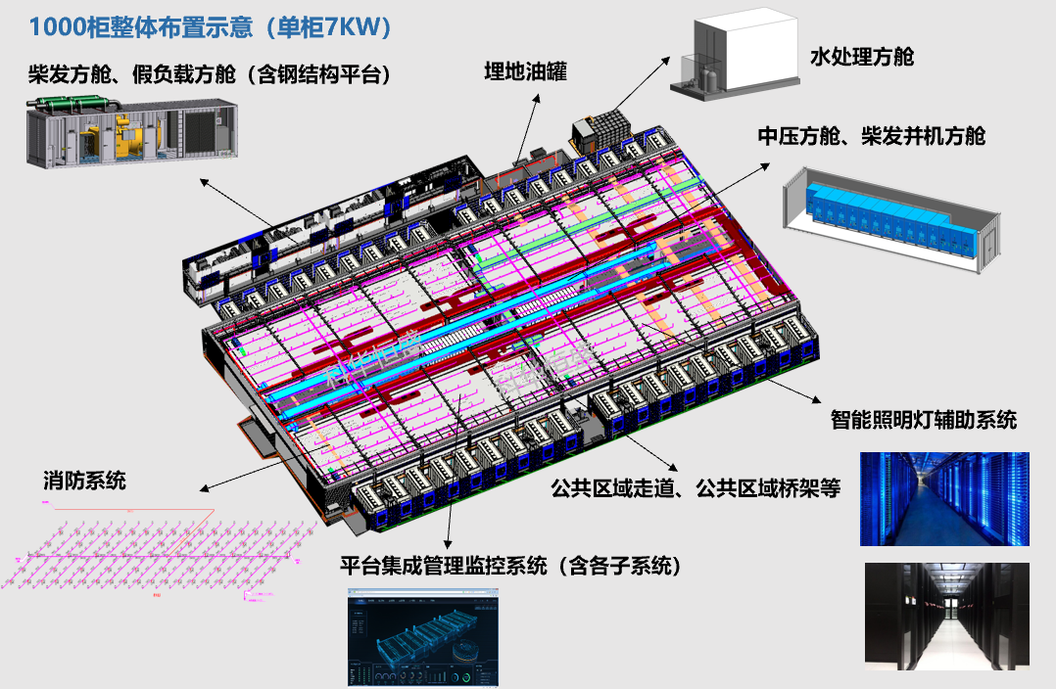
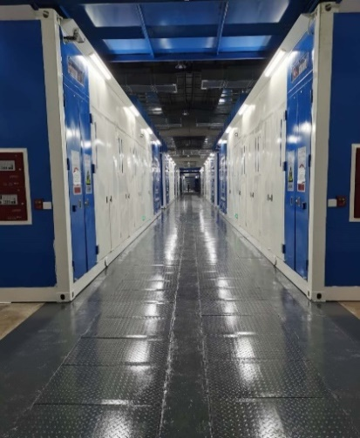
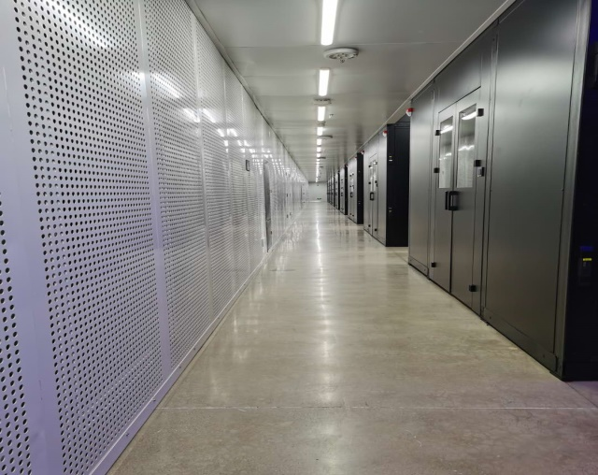

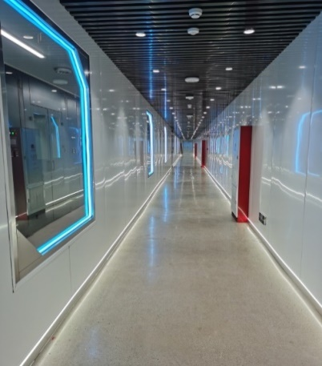
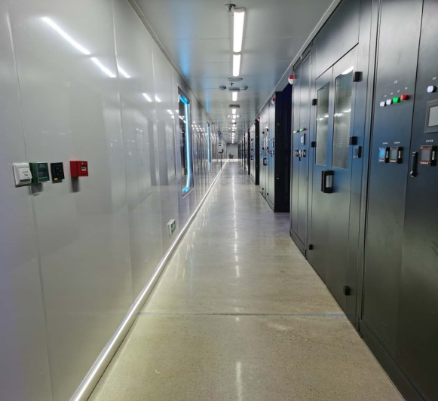
Pre-BLOCK Container
1000 Rack layout (7kW/rack)
Diesel container
Water treatment
diesel oil tank
Medium volt & diesel
Illumination
Fire depression
Public area & corridor
DCIM
Notes:
与腾讯合作的项目：设计、建设、运营为科华。
示例：1000个柜规模的BLOCK项目展示，单机柜功耗7KW
左上：电力方舱
右上：空调出风静压仓
左下：参观通道
右下：维修通道

Slide 18
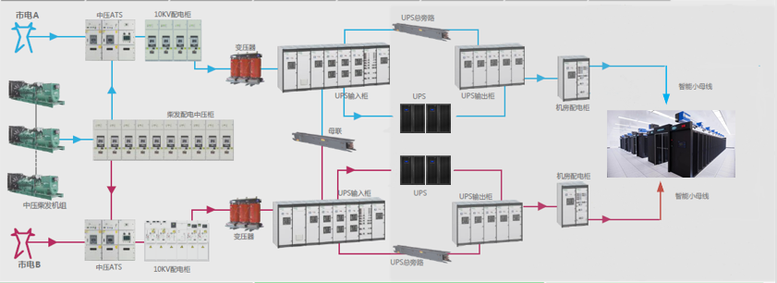
Power Supply Chain
2N，T3/T4 Level
Dual input
Medium volt cabinet
Medium volt Transformer
UPS input cabinet
UPS
UPS Output cabinet
Distribution cabinet
Busway
Load
Diesel cabinet | Medium volt cabinet | 10KV AC input/ UPS or HVDC power container | BOX container
Notes:
按T3/T4标准的配电架构

Slide 19
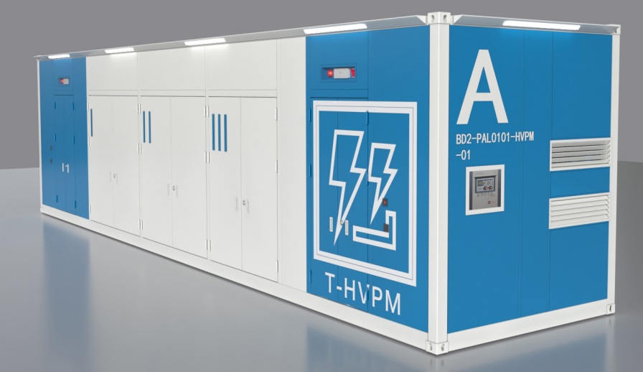
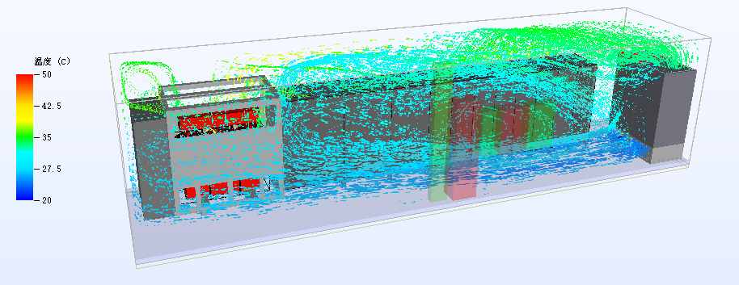
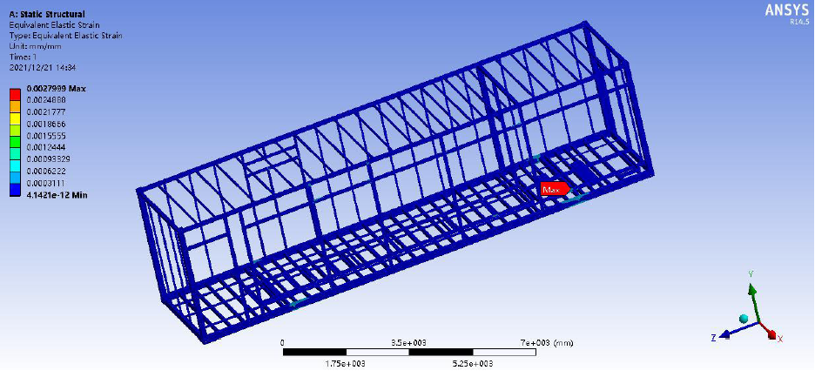
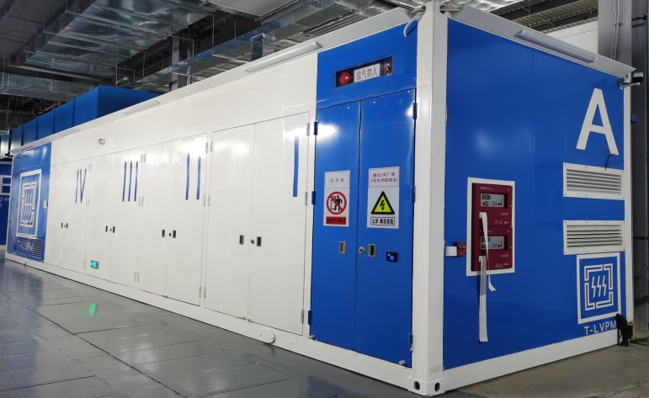
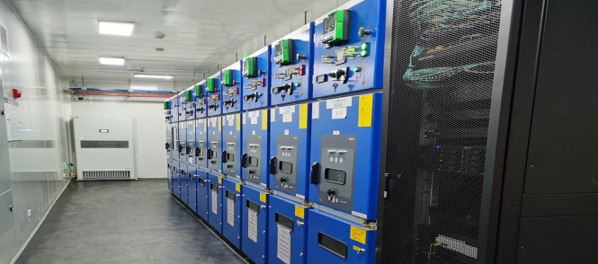

Power supply Container
Power Supply Container
2N，T3/T4 Level
Appearance CI design
Air flow CFD simulation
Structural dynamics simulation
Production
Medium volt cabinet
Low volt cabinet
Notes:
电力方舱设计链路与实物展示
1.外观
2.风场仿真
3.应力仿真
4.实物展示

Slide 20








Block Container（IT loads area）
Top floor return air outlet
Maintenance
corridor
Cable corridor
Main corridor
Cold air
area
Cold
channel
Maintenance
corridor
BOX
Notes:
IT方舱的架构及内部展示

Slide 21












Block Container（IT Loads Area）
Present as a row
Including frame, door, sunroof, etc
3 BOX consist as a module
IT racks （including PDU）
Rapid installation by flat cart
Distribution
cabinet
HVDC/UPS
Battery
cabinet
Control
cabinet
Notes:
IT方舱BOX模块的内部配置介绍
包含：列头柜+UPS/HVDC+电池+管控
工厂完成预制，现场只需要拼接，减少现场的工程量，缩短交付时间

Slide 22






Cooling Container
Cooling container
Water treatment container
Notes:
暖通架构
上：AHU，科华具备CFD仿真能力，可进行空调设备、机房整体系统的仿真，提前验证和优化设计方案
下：水处理方案及实物展示

Slide 23



THANKS
www.kehua.com
Kehua Data Co., Ltd. Statistics: By the end of 2022
Source：Frost & Sullivan, OMDIA, CCW, FORWARD, CCID, Dun&Bradstreet, etc.

